Slide 1
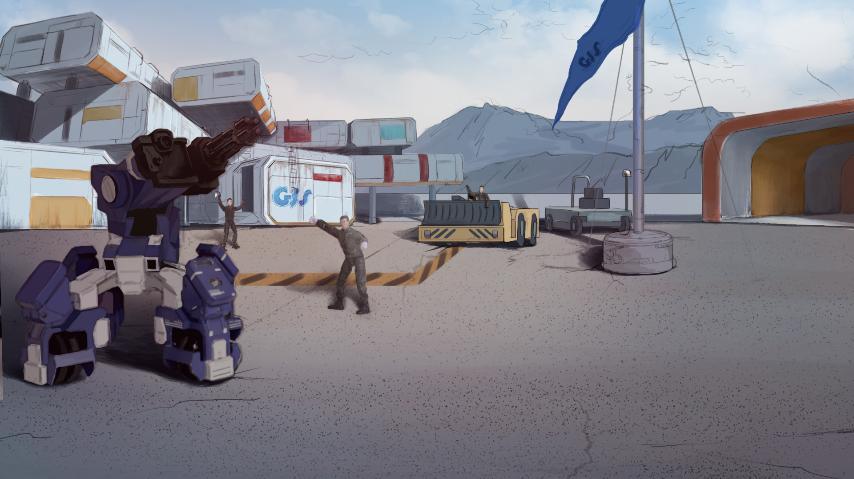
How to Become A GEIO Pilot？
Lesson 16: The Final Charge

Slide 2
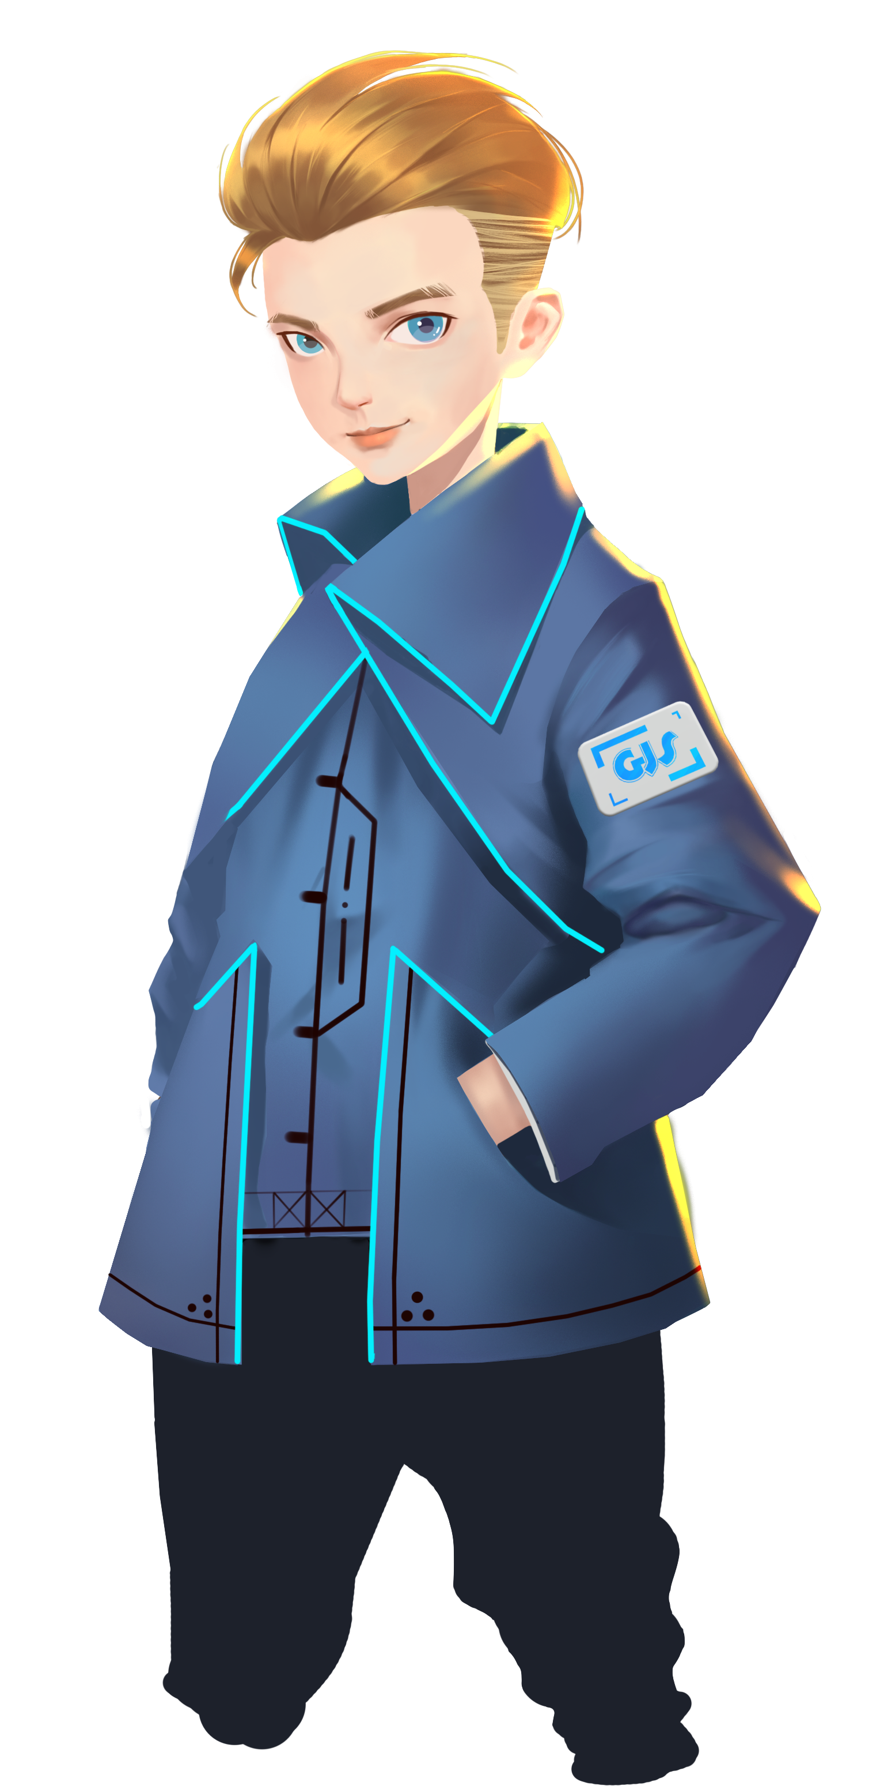
How do we know the result of logo recognition?
How to build a logo recognition system?
What’s the difference between “If” and “If…else”?
Last time, we successfully found and destroyed the enemy armoury, and gave the enemy a great strike on their morale. Now the final battle has come. destroy the terrorists, and restore peace for the whole world!
Welcome back fellow pilots! I am Sam. Do you still remember what we have learnt last time?

Slide 3
Briefing

Slide 4
Topic
“The Final Charge”
Training
Control panel building
Challenge
Beat the opponents in free battle
In the Briefing section, let’s see what we are going to do today.

Slide 5
Training

Slide 6
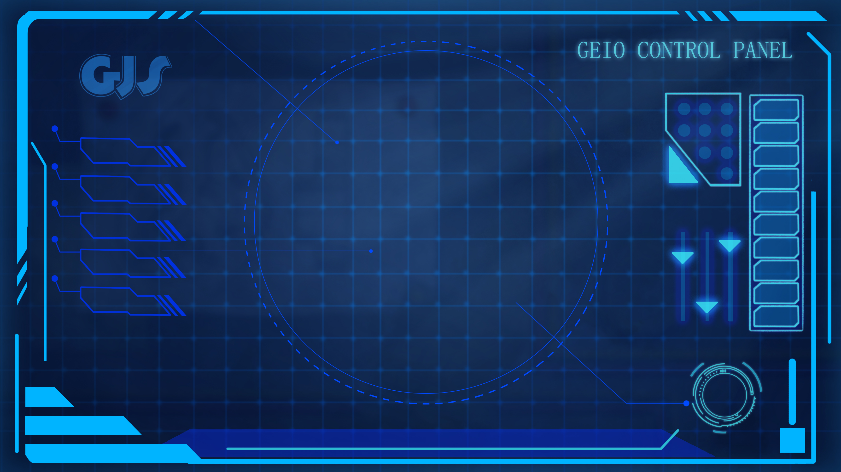
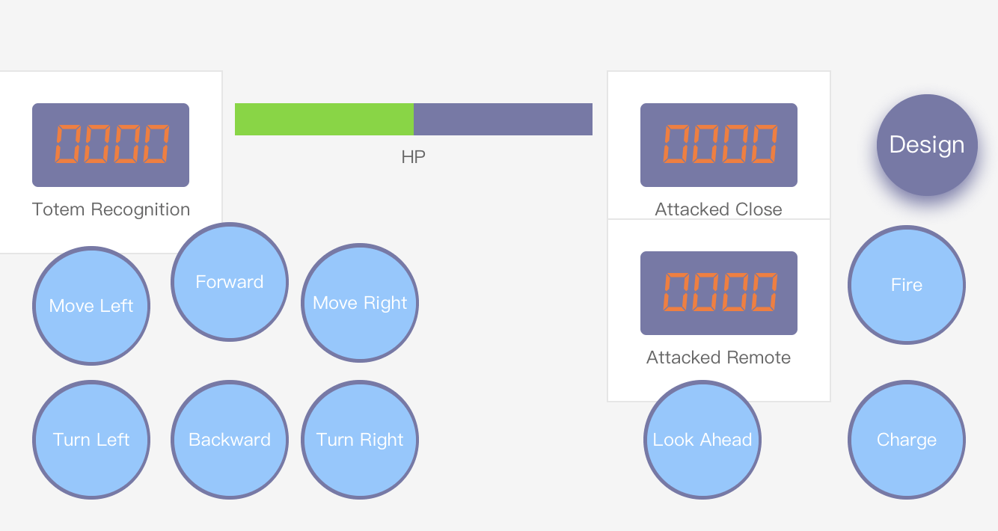
Training task 1: Programme GEIO so that it is able to engage in close combat and gun fight ( with ammunition limitation and emergent reload). Programme to display the number of been attacked.
Training task 2: Build the totem recognition system. If GEIO recognise the medic totem before losing all its HP, the system will automatically restore GEIO’s HP.
Training task 3: Build the motion control system using “Button”, and HP display system.
The final control panel should be like this.
Everything is ready. Attack!

Slide 7
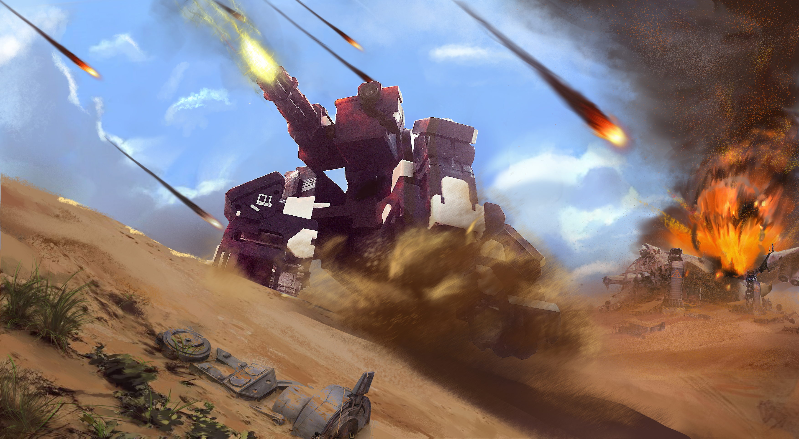
Challenge

Slide 8
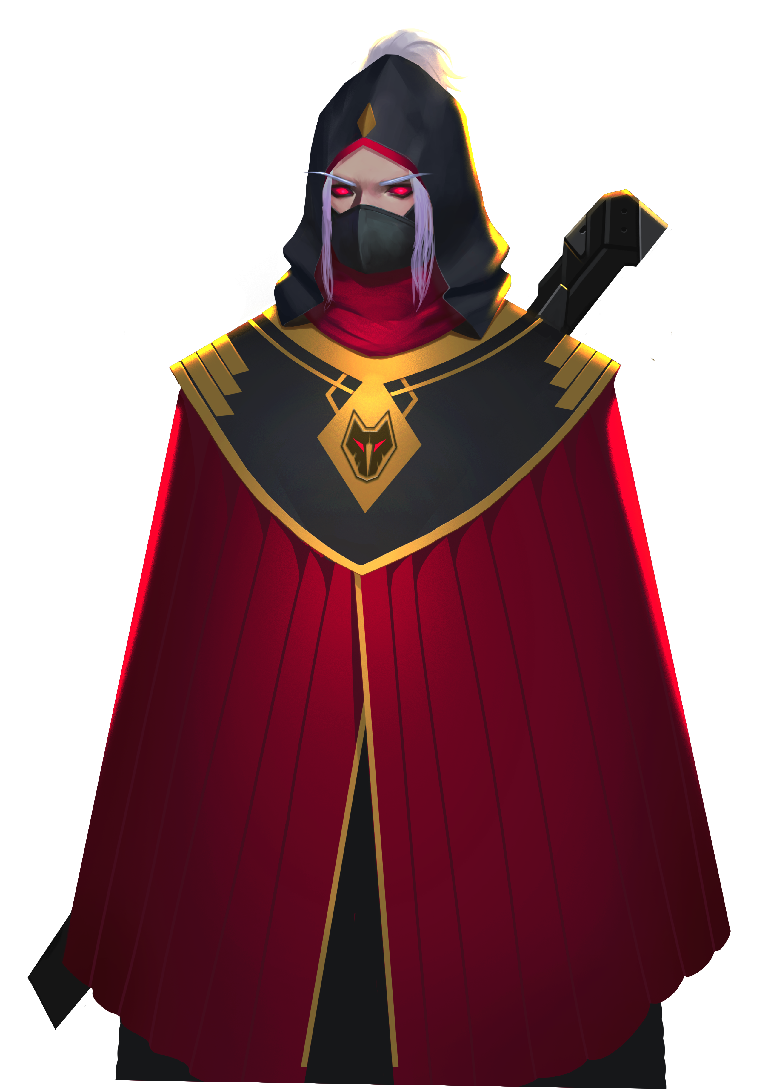
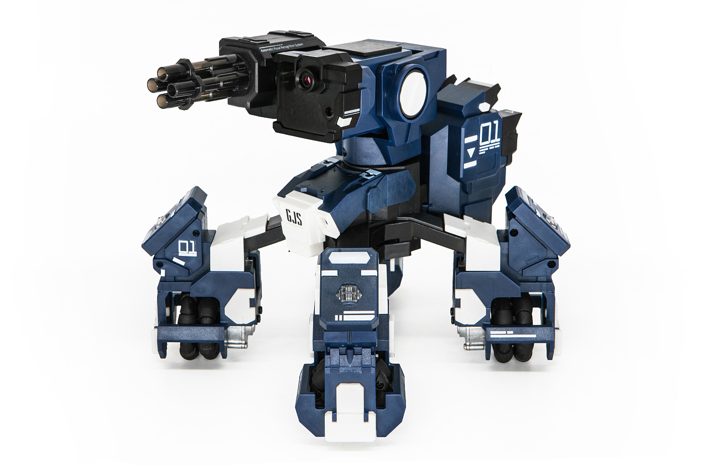
E
D
C
B
A
1
2
3
4
5
6
7
8
Boxes in C3 and C6 are attached with the medic totems. If you are taking great loss of HP, do come back and restore your HP by recognise the totem.
This is our final battle field. Every two of you will form a team to join the battle.
You can use the obstacles as cover. The last team standing will be the winner!
Pilots, this is the last battle. Try all your best, and defeat your enemy!
I will not yield! Come on! I will make you cry!

Slide 9
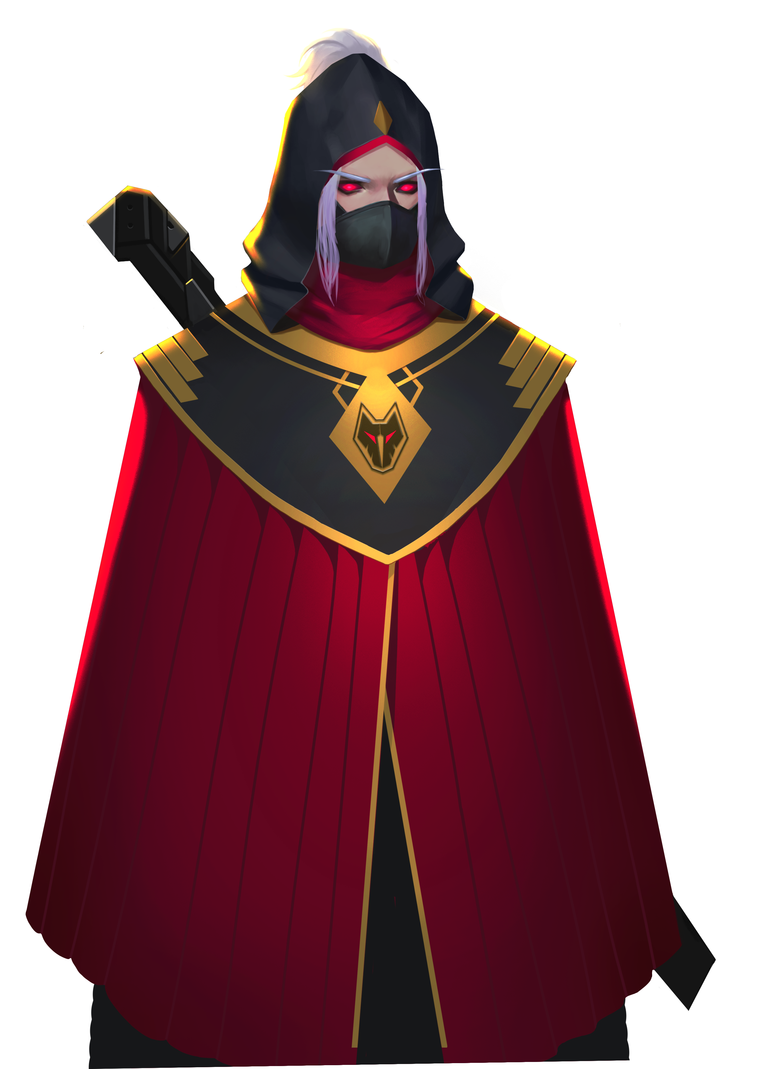
It is my honour to have been fight along with you. You have proved yourself to be
a true GJS fighter. Goodbye my friend! Hope we can be fighting together again!
Victory! We have destroyed Fenrir and all the terrorists!
War and chaos is ended. Peace and order is restored.
I…lost…again…this is my end…

