Slide 1
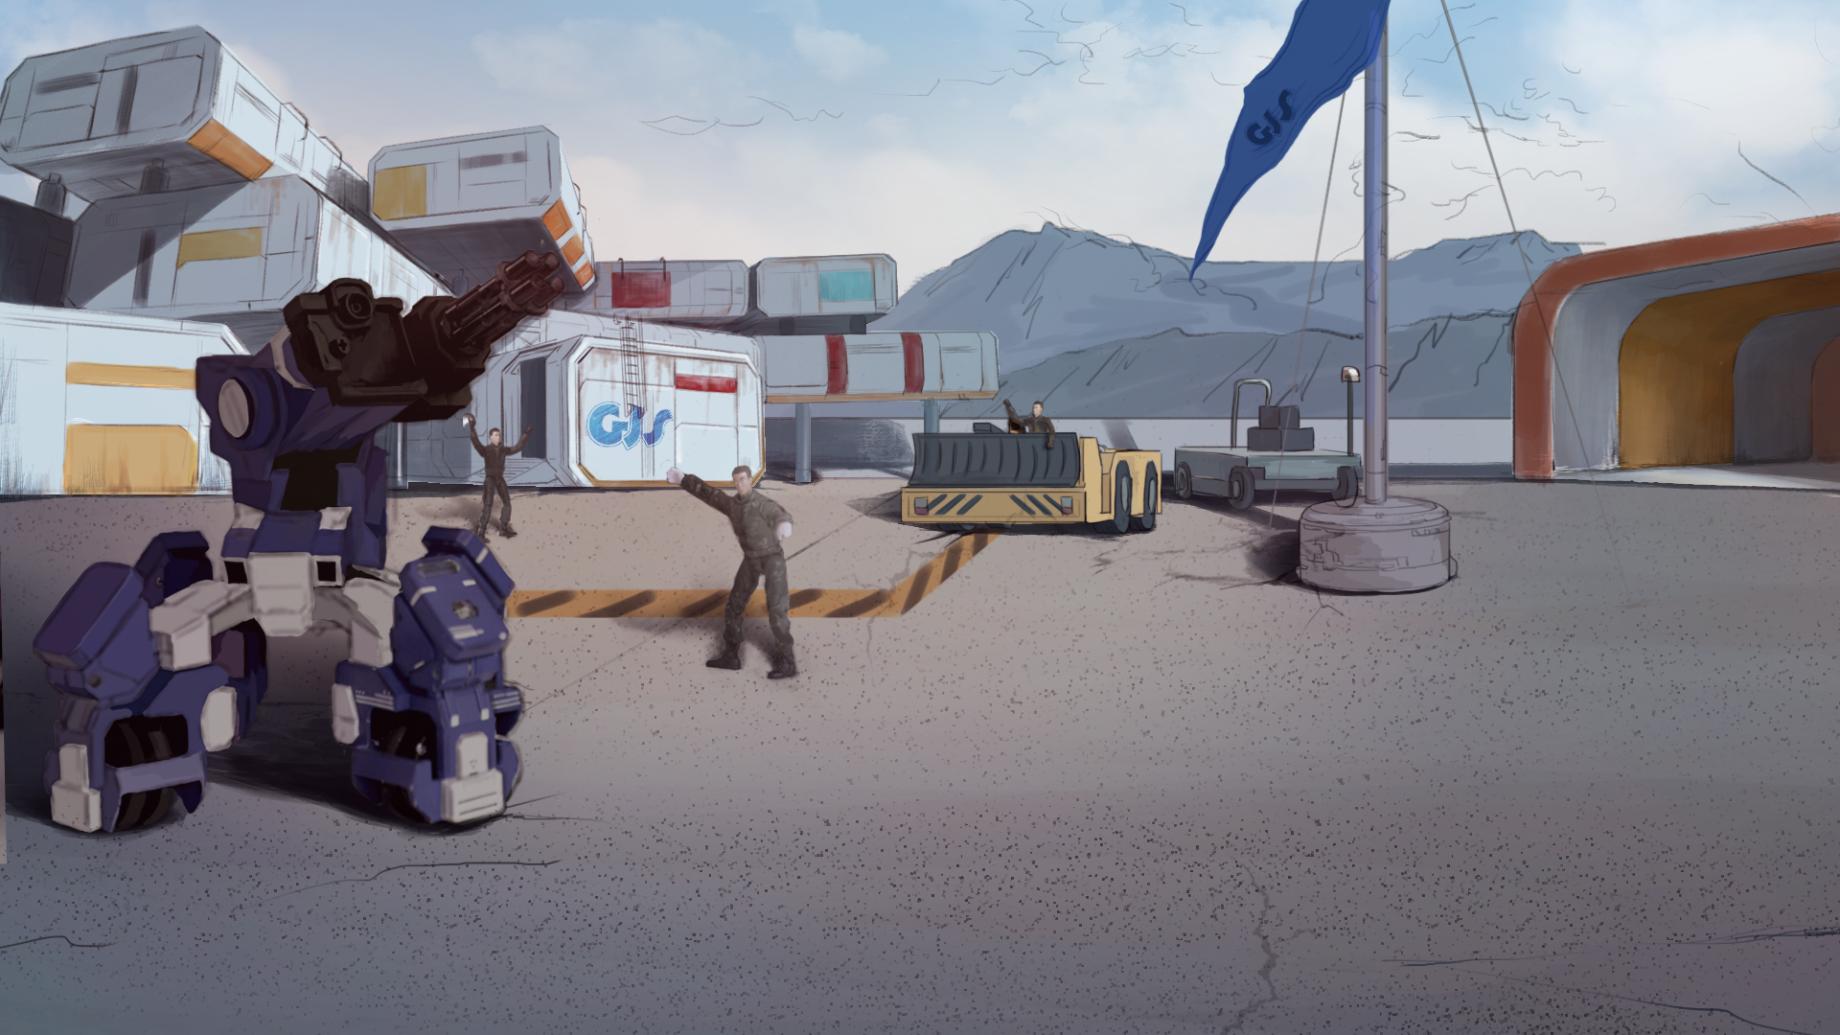
How to Become A GEIO Pilot？
Lesson 11: Clear the Road

Slide 2
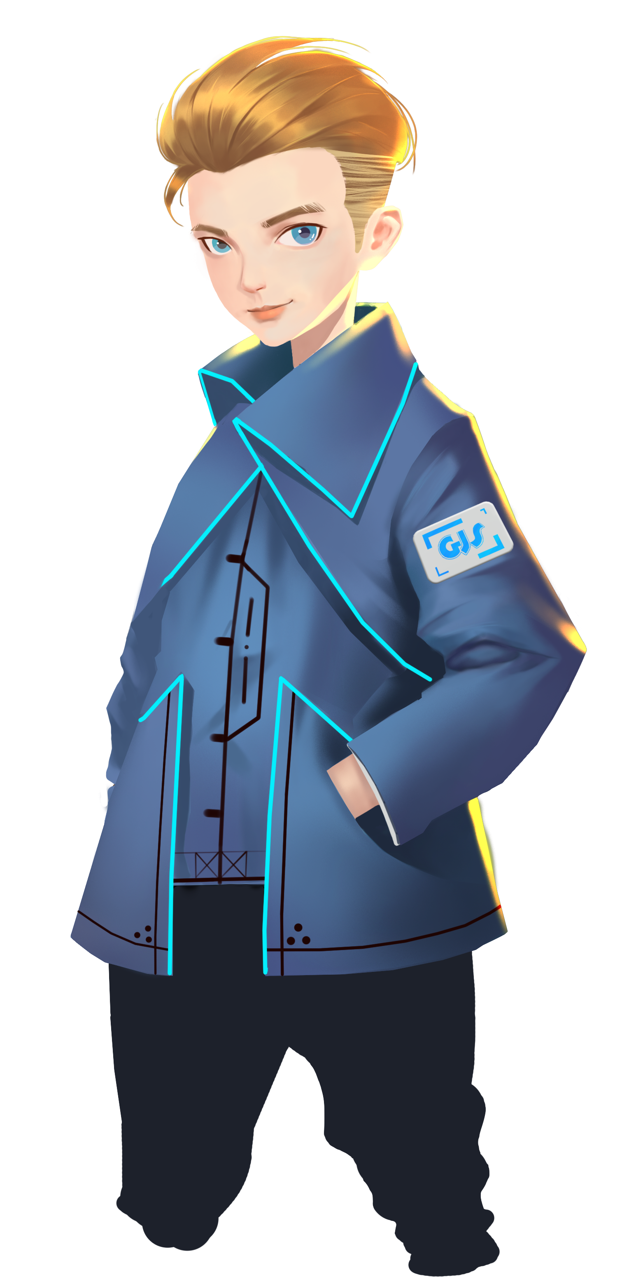
What are the most common geometric figures?
What are the features of a square and a equilateral triangle?
How to optimise the patrol route?
Attention! A highway connecting our camp to the nearest city was damaged by
a band of terrorists. The HQ just ordered our squad to repair the highway asap.
Welcome back fellow pilots! I am Sam. Do you still remember what we have learnt last time?

Slide 3
Briefing

Slide 4
Topic
“Clear the Road”
Basic Knowledge
GEIO’s logo system
Training
Logo recognition and object removal
Challenge
Look out, IED!
In the Briefing section, let’s see what we are going to do today.

Slide 5
Basic Knowledge

Slide 6
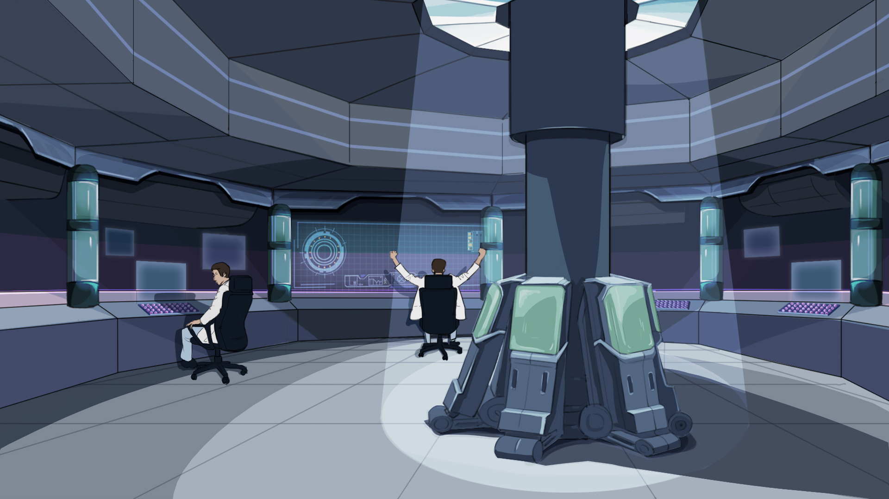
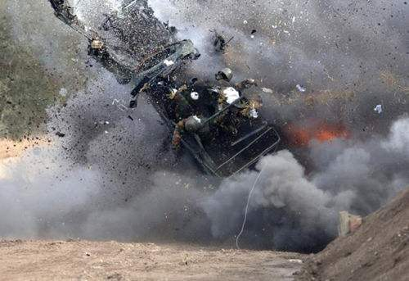
Fortunately, our engineers have already tagged those suspicious rocks with logos.
Our job is to remove the other rocks so that the engineers can disarm those IED more easily.
What makes things worse is that they planted several IED (Improvised Explosive Devices) —
bombs that covered by rocks and ruins, in order to attack us when we try to clear the rocks.
According to the latest intelligence, the terrorists not only damaged the road,
but also placed a lot of huge rocks to prevent us from reaching the city.

Slide 7
Question: Every logo consists of a figure, a square box and four dots. Is GEIO
still able to recognise the logo if we cover part of the square box or the dot?
When GEIO’s camera captures such logos, it would automatically give
a sound alerting the successful recognition. We can have a try now.
As for the totems, there are 10 different logos that can be recognised by GEIO.

Slide 8
Training

Slide 9
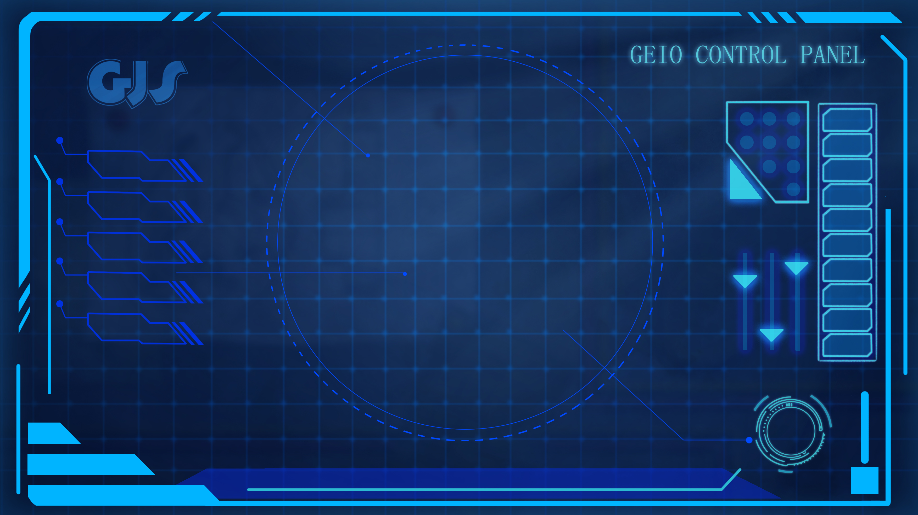
Training task 1: Use “Button” to programme and control GEIO’s motion. Let GEIO get
close to a box on which a logo is attached, and stop when GEIO recognises the logo.

Slide 10
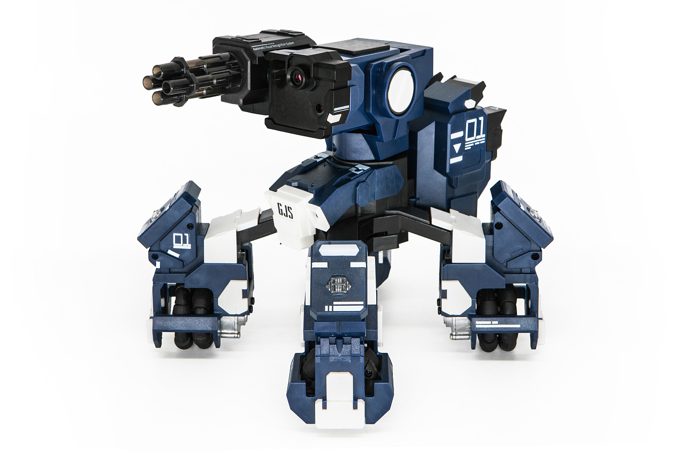
E
D
C
B
A
1
2
3
4
5
6
7
8
Training task 2: Control GEIO to move the box. There are four boxes in the training field.
Programme and control GEIO to go along the direction of the arrow, and push the boxes
to the yellow area one by one. You can only use “Button” to control your GEIO.

Slide 11
Challenge

Slide 12
E
D
C
B
A
1
2
3
4
5
6
7
8
Alright pilots, now we are going to the practical field. There are 7 big rocks on the road to be
cleared away. Among them, two rocks may be IED, and were tagged with logos. Programme
and control your GEIO using “Button”, clear the other rocks and leave the IED where they are.

Slide 13
How many logos can be recognised by GEIO?
How does GEIO recognise a logo?
What else can we do with the logos?
Very good. One more thing to do. We must find out the criminal
responsible for this attack. No attacks on the peace is tolerable!
OMG… That was close! But we finally finished the job! Well done fellows!
Now it is the time for review. Answer the above questions.

