Slide 1
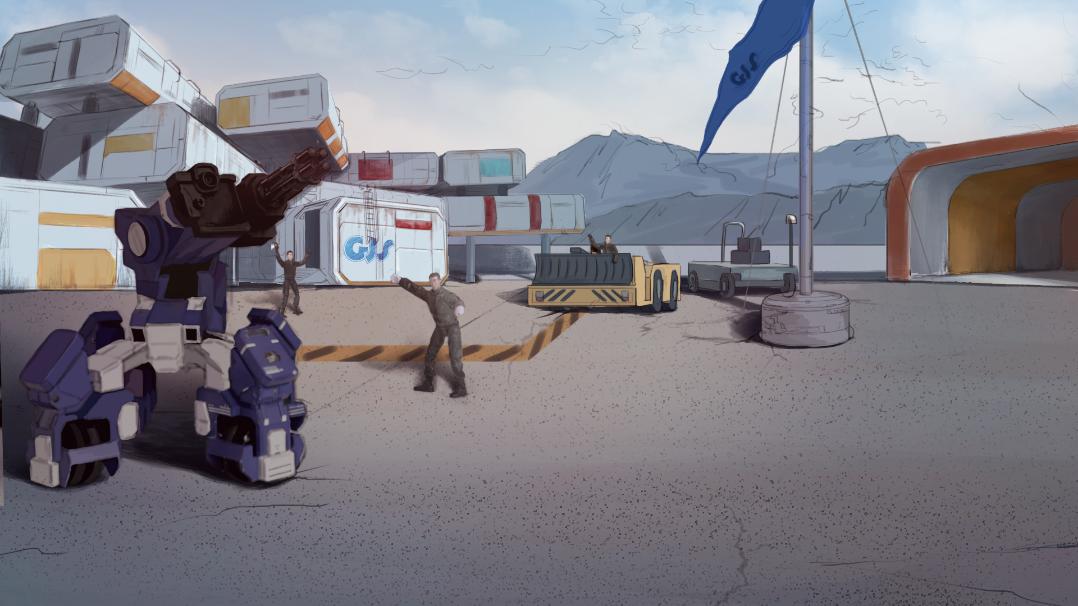
How to Become A GEIO Pilot？
Lesson 10: Path Planning

Slide 2
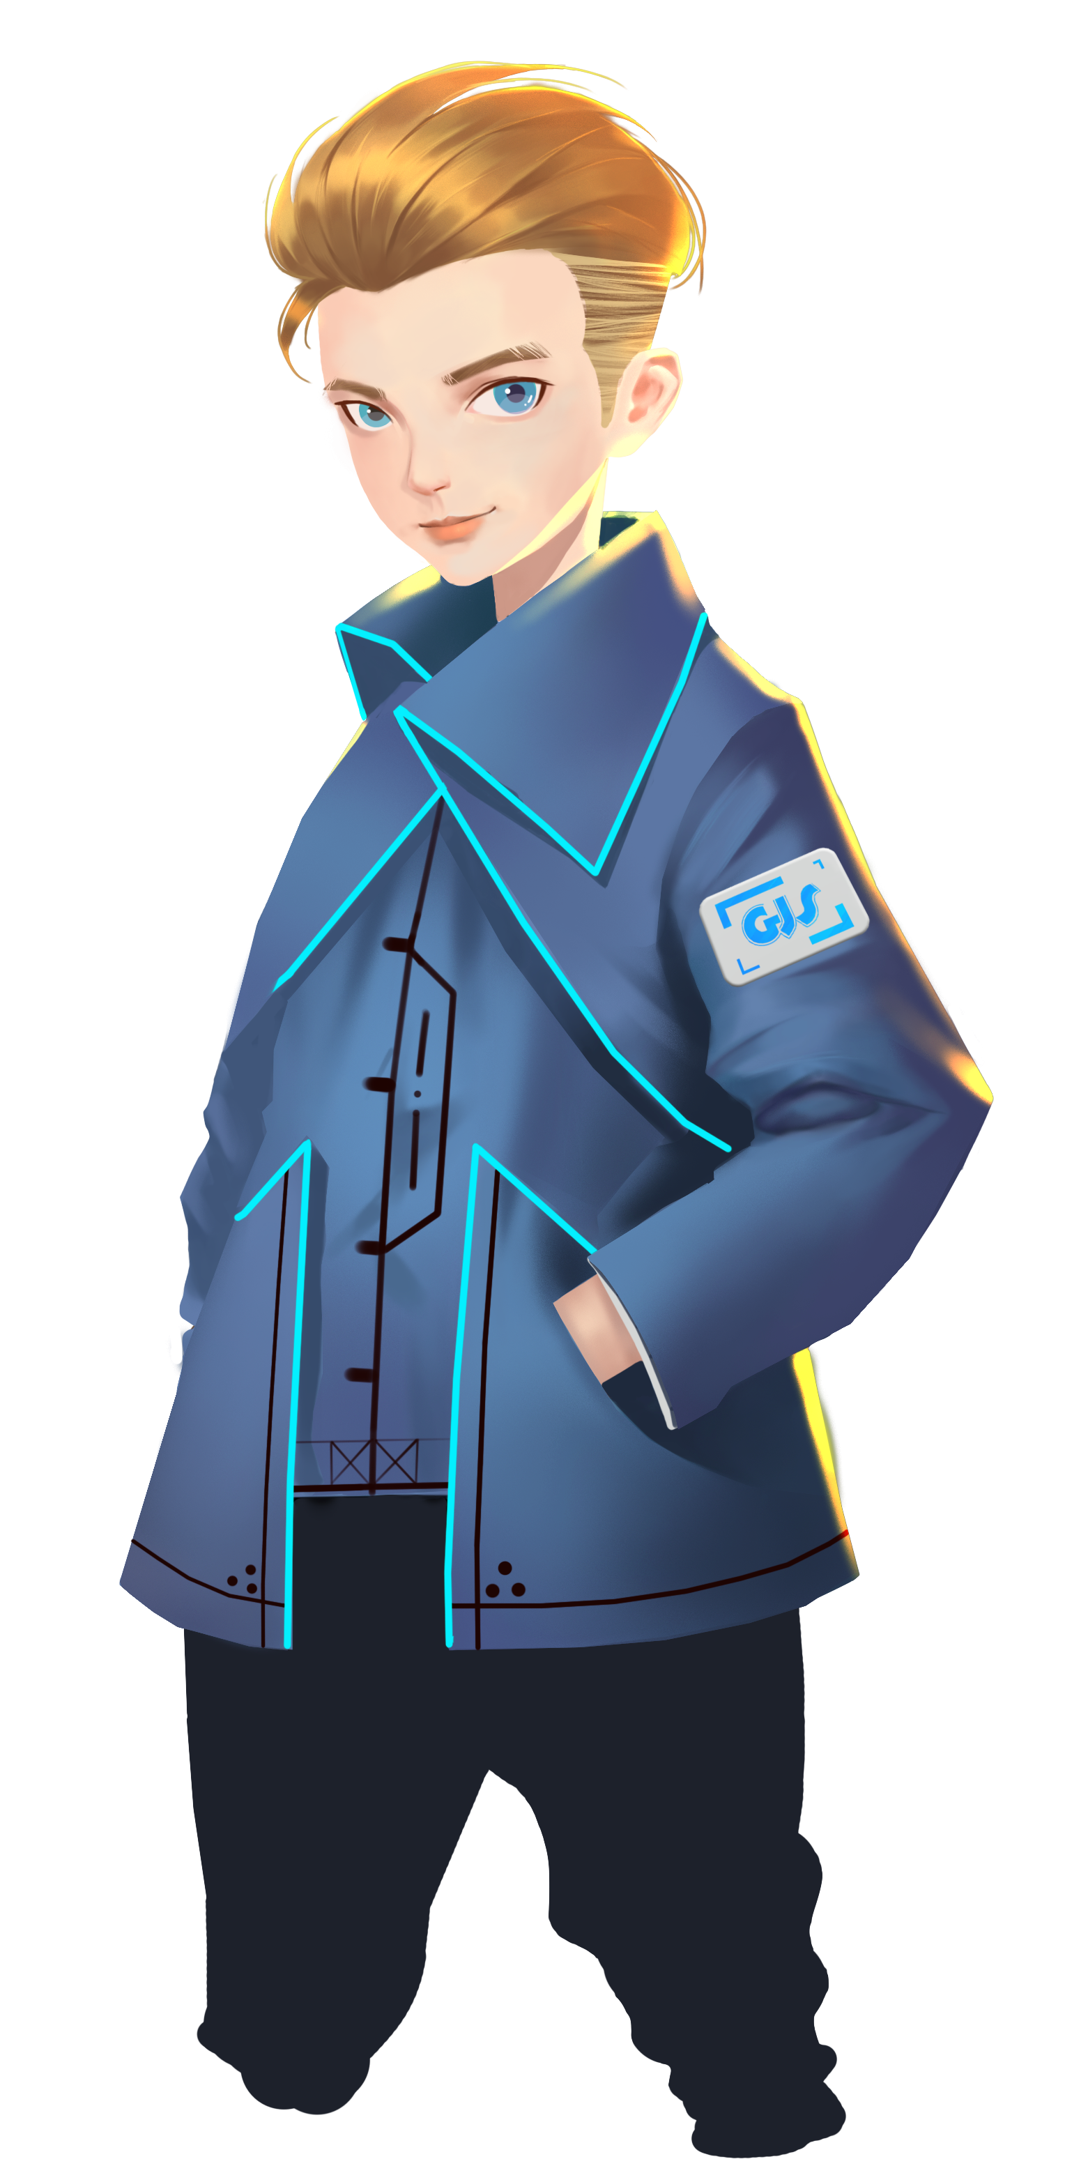
What is variables?
What should we do before using a variable?
How many ways of calculating variables are there?
How does it feel to be an official GJS soldier? You have done great jobs last time,
but can you be as good this time? Come on let’s see what we are going to do today!
Welcome back fellow pilots! I am Sam. Do you still remember what we have learnt last time?

Slide 3
Briefing

Slide 4
Topic
“Path Planning”
Basic Knowledge
Geometry and path planning
Training
Draw some shapes
Challenge
Find the best route
In the Briefing section, let’s see what we are going to learn today.

Slide 5
Basic Knowledge

Slide 6
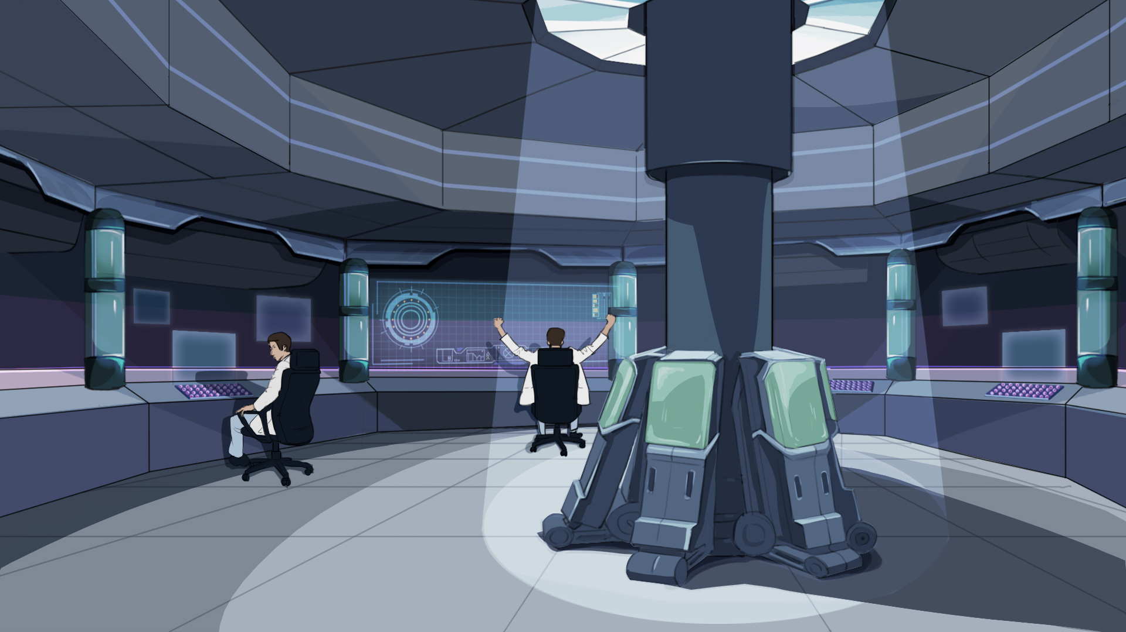
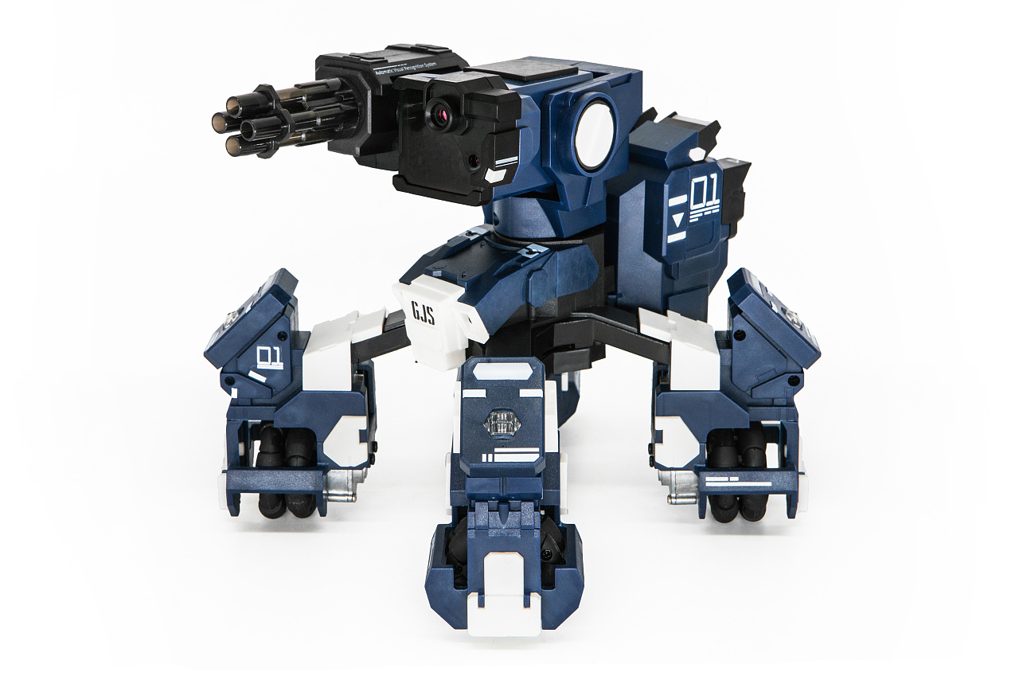
Start
Look around
Turn 180°
Last time we did our first patrol in the camp. But we just let GEIO move in a straight line.
That is not good enough since our camp is big, and GEIO is unable to see every corners.
Thus we should plan a better route that may cover most of the camp.
To do this, let’s first learn about geometry.

Slide 7
Rectangle (square here), triangle, and round (circle) are the most common 2-D geometric
figures. Can you tell the features of these figures? (angles, numbers and length of sides, etc.)
Geometry is the science that studies spatial structures.
It is one of the most fundamental studies of maths.
After knowing these figures, I’d like you to control GEIO to draw paths in such figures.
That may be to abstract. Let’s take a look at the above figures.

Slide 8
Training

Slide 9
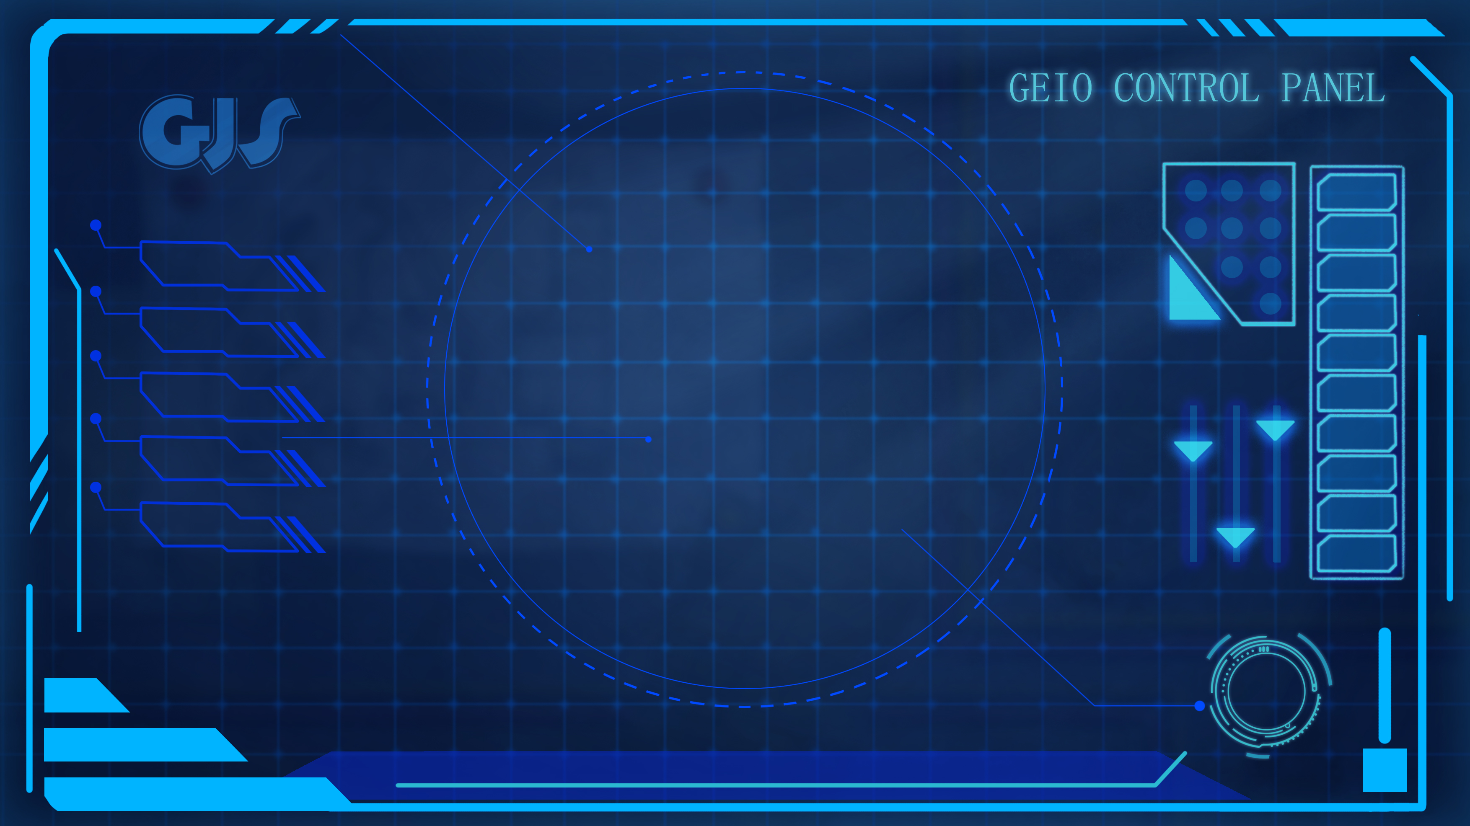
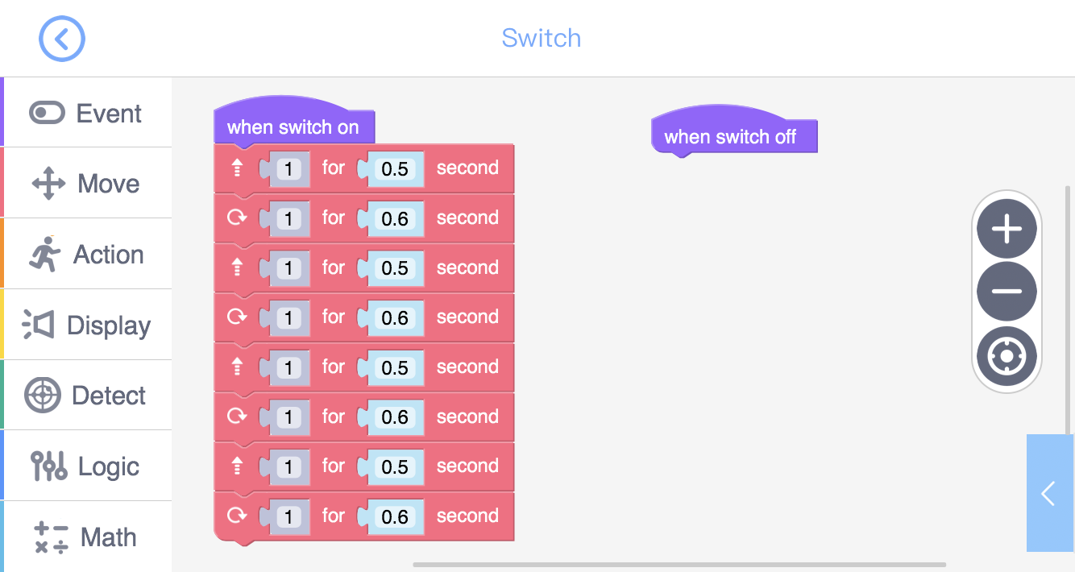
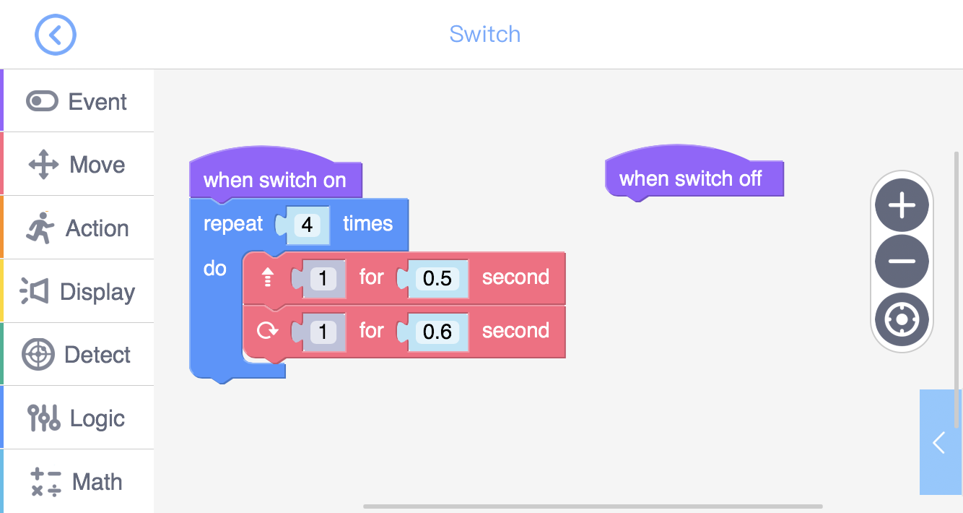
The above programme could do the job. Moving forward could be considered as drawing the
line of the square, and turning 90° could be considered as drawing the angle of the square.
Question: How many codes do we use in this programme?
Training task 1: Use “Switch” to programme and control GEIO, make it
draw the path of a square (side length 30cm). When the programme
ends, GEIO should return to exactly the same place.
Then take a look at the second programme. What is the difference?
Is this programme able to do the same job as the last one? Why?

Slide 10
From the last task, we know that the use of “Repeat times” code could reduce the
number of codes of the programme. But why do we need to reduce the number of codes?
Let’s do maths again: 2x10=? The answer is also 20.
But this time we only need to calculate once, which is comparatively more efficient.
Let’s do the maths: 2+2+2+2+2+2+2+2+2+2=?
The answer is 20. But we should calculate 10 times, which is time consuming.
In the programme, we can consider “Repeat” code as the multiplication, as it
reduces the number of codes and increases the efficiency of the programme.

Slide 11
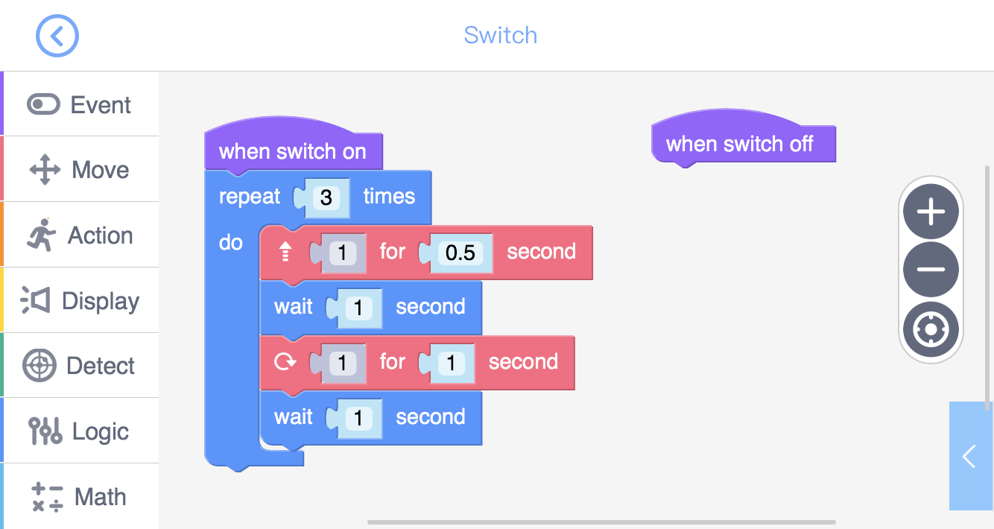
B
120°
60°
C
D
A
In the above image, we assume that GEIO moves from point C to point A. When it reaches A, it should turn its direction from Line AD to Line AB. We have already known that Angle DAC is 180°, and Angle BAC is 60°, and thus Angle DAB is 120°. So, GEIO should turn 120°.
What is a equilateral triangle? If the length of all the three sides of a triangle are all the same, then this triangle is equilateral. Moreover, the three angles of the equilateral
triangle are all 60°. Now try to draw such a figure.
Problem with the angles. The angle of a equilateral triangle is 60°, but why
can’t we draw the proper figure after GEIO turns 60° at each turning point?
Training task 2: Let GEIO draw the path of a equilateral triangle (side length 30cm).

Slide 12
Challenge

Slide 13
1
 |  |  |  | 3
 |  |  |  |  |  |  | 4
 |  |  | 2
E
D
C
B
A
1
2
3
4
5
6
7
8
Today you are required to go patrol in the whole camp. We noticed that in our camp there are several buildings (blue blocks), and 4 check points. Your job is to let your GEIO start from C1, and reach each of the 4 check points in numerical sequence, without hitting any building.

Slide 14
What are the most common geometric figures?
What are the features of a square and a equilateral triangle?
How to optimise the patrol route?
Now it is the time for review. Answer the above questions.
Excellent pilots! You are acting like true GJS soldiers now.

