Slide 1
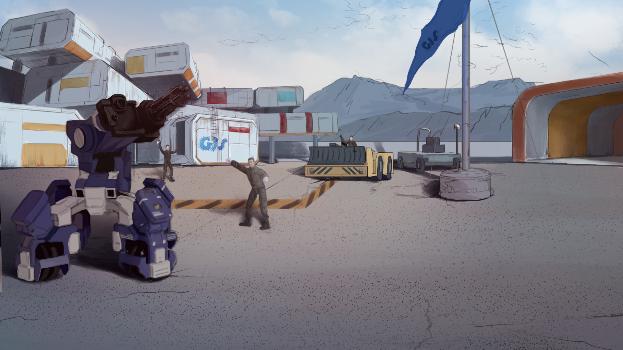
How to Become A GEIO Pilot？
Lesson 1: Welcome to GEIO Training Camp

Slide 2
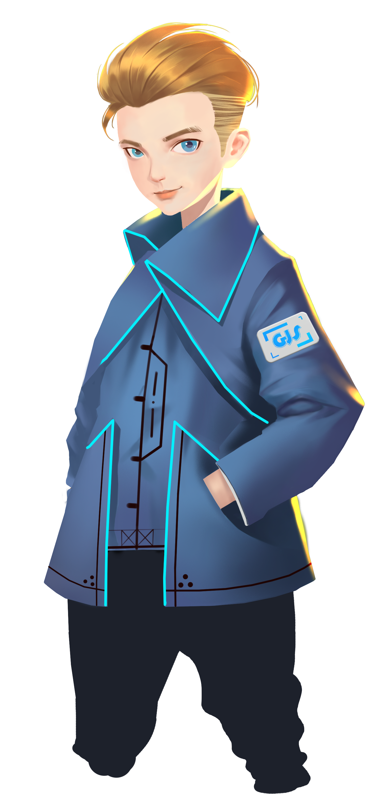
Hello, everyone! Welcome to GEIO Training Camp!
My Name is Sam, and I will guide you through the coming GEIO pilot training course.
I hope you all will become excellent GEIO pilots!
Before we begin our training course, I’d like to introduce the camp to you.

Slide 3
Briefing
Introduce the main content of this lesson
Basic Knowledge
Learn the knowledge needed to finish the job
Training
Finish two basic training tasks
Challenges
Face the challenge, and test your skills
Here in the camp, you will get to know GEIO—the coolest fighting robot around the globe. After 16 intensive training lessons, you will be able to programme and operate GEIO, and finish various challenges.
There are four sections in each lesson:
Briefing, Basic Knowledge, Training, and Challenges.
Now, let our course begin!

Slide 4
Basic Knowledge

Slide 5
High accuracy
Daily service
Follow men’s commands
Industrial production
Able to work in bad environment
Military actions
Never tired
First of all, can anyone tell me why human need robots?
Great! Then let’s see what does GEIO look like.
Then what can robot actually do for human?

Slide 6
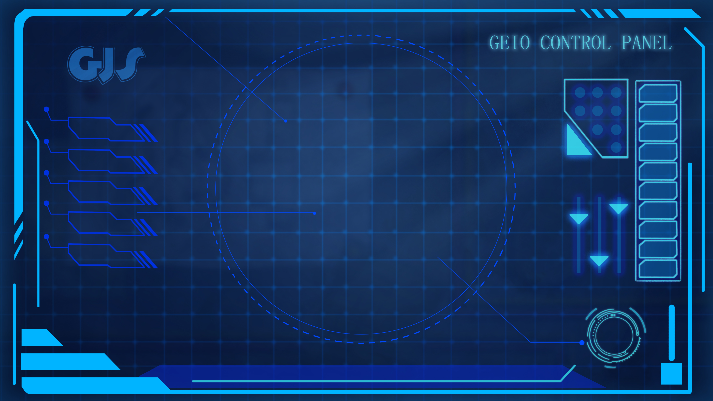
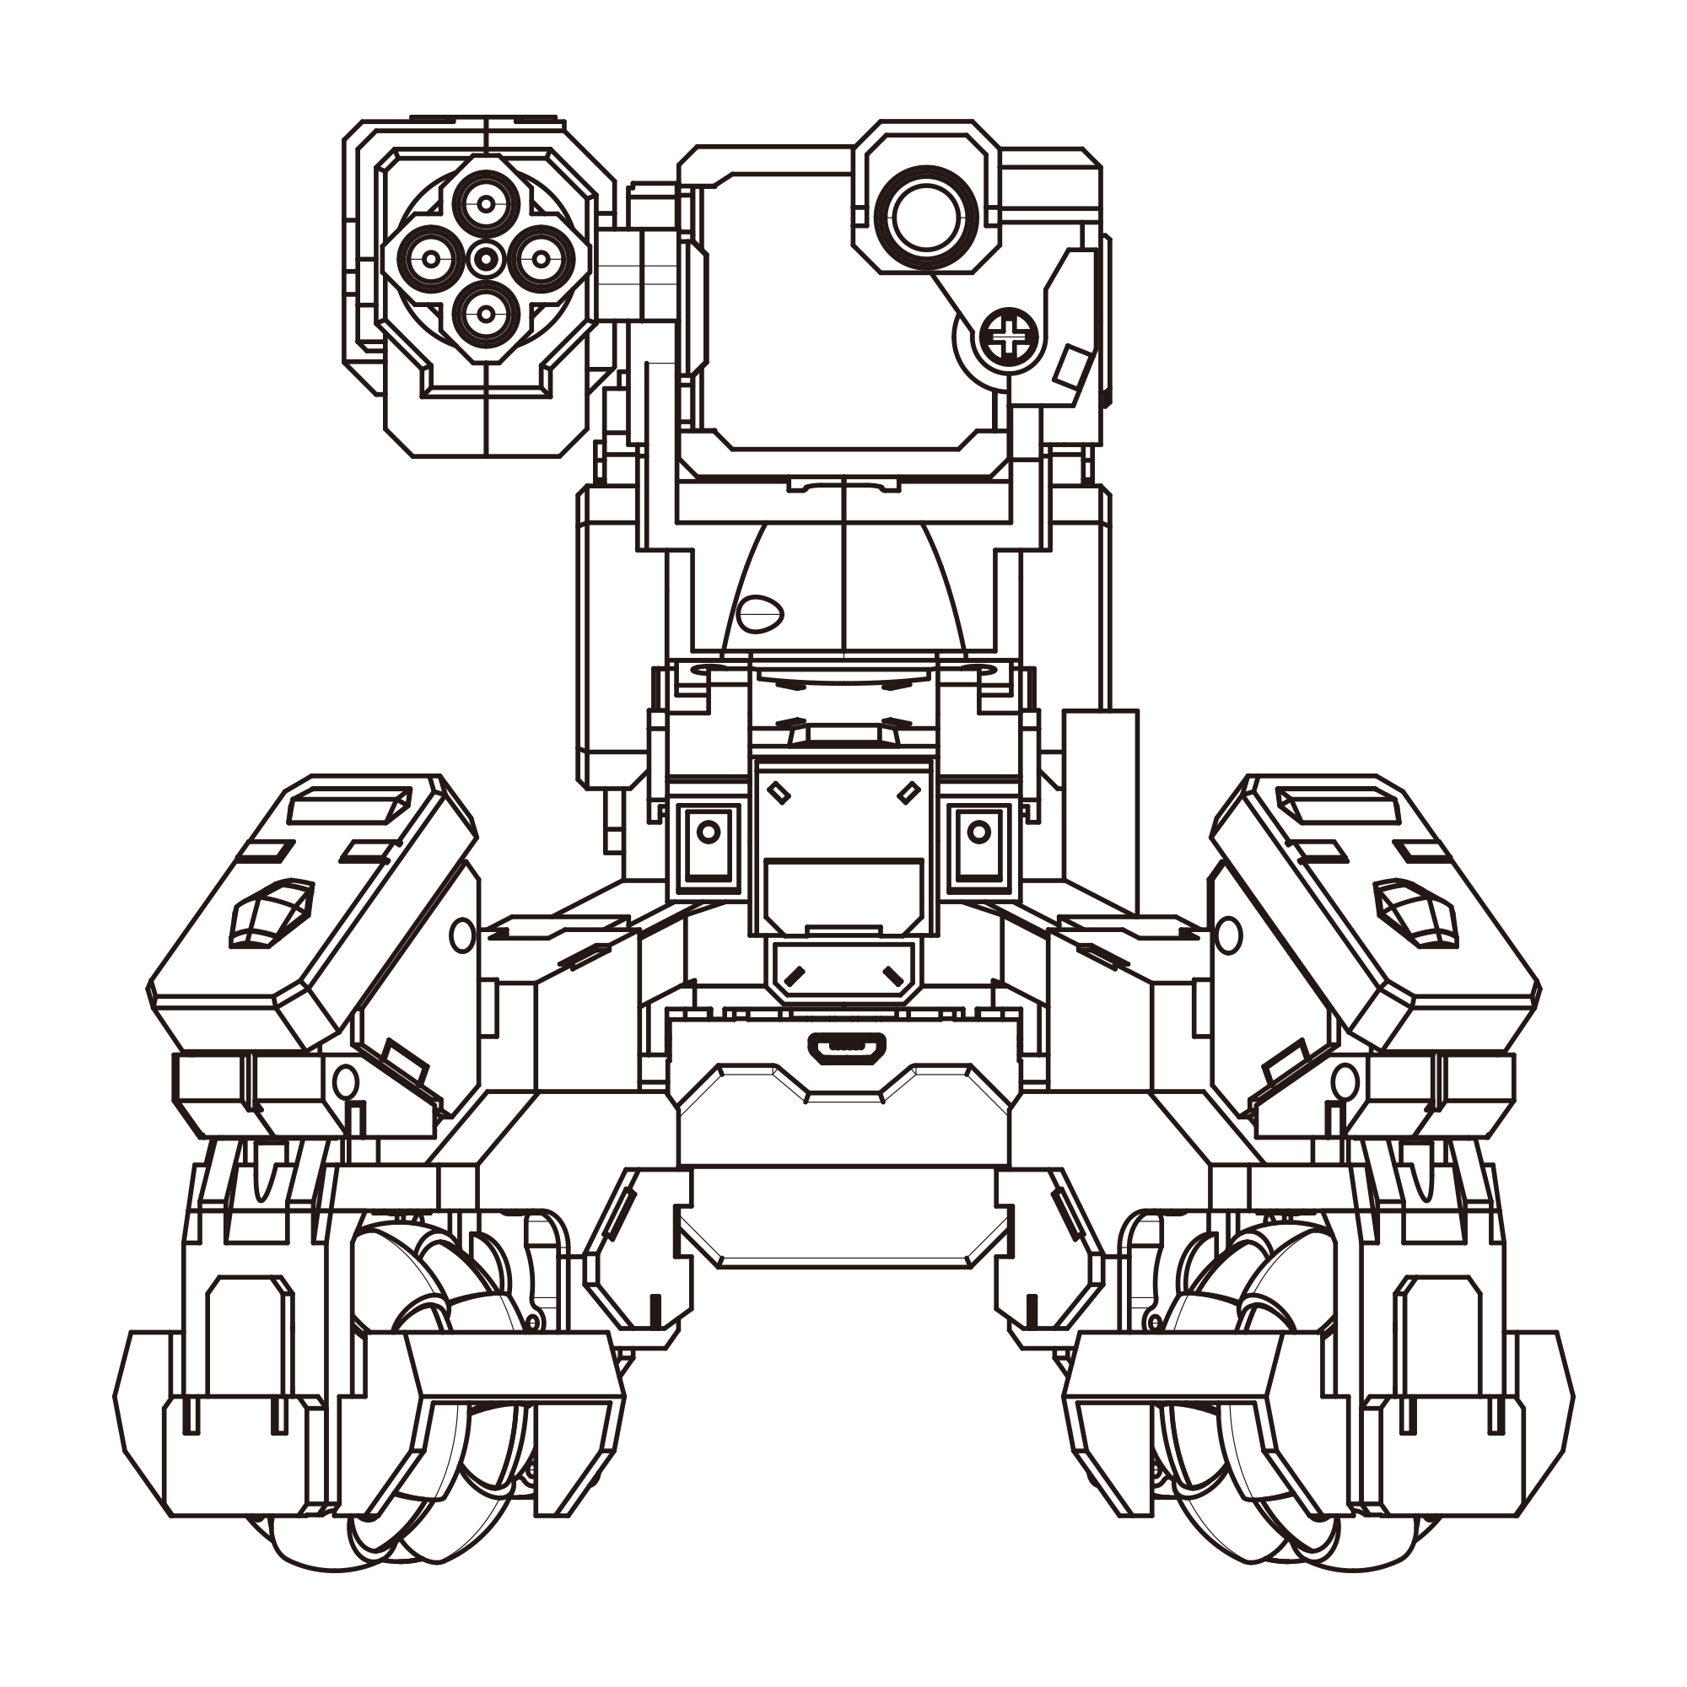
Laser machine gun
Camera
Controller
Laser receiver
Wheels
The camera and laser receiver are GEIO’s sensing modules. The wheels and laser machine gun are the executing modules. But they are all controlled by the controller—GEIO’s brain.
Actually, most of the robots on earth consist of these three parts: sensing modules, executing modules and the controller.
This is GEIO. The above picture shows the main parts of GEIO.
But how can we control GEIO? We need to programme it.

Slide 7
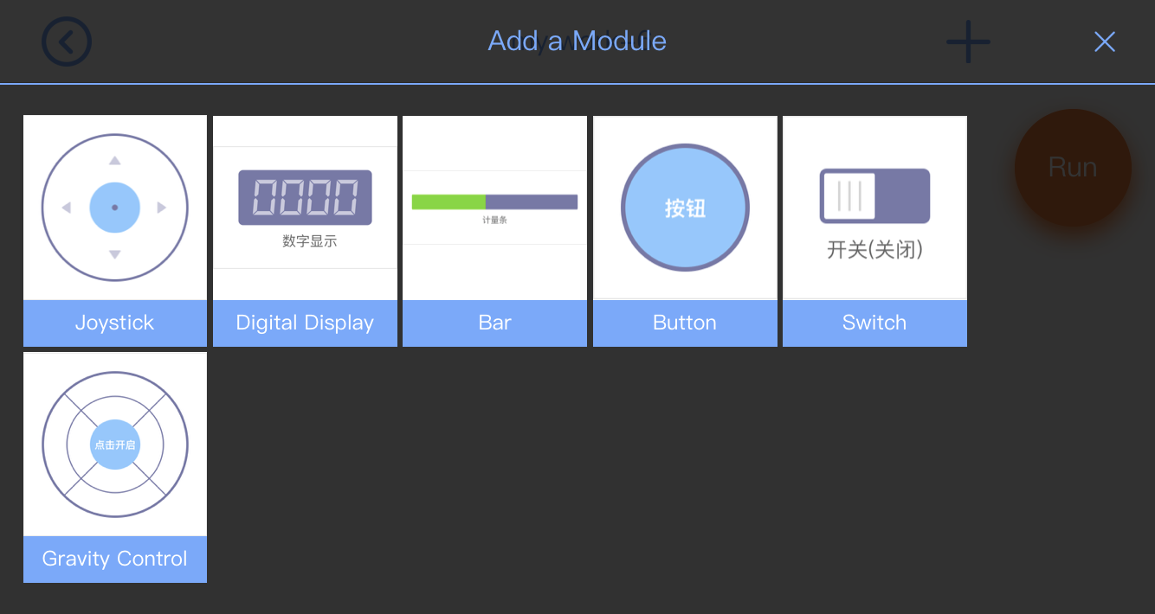
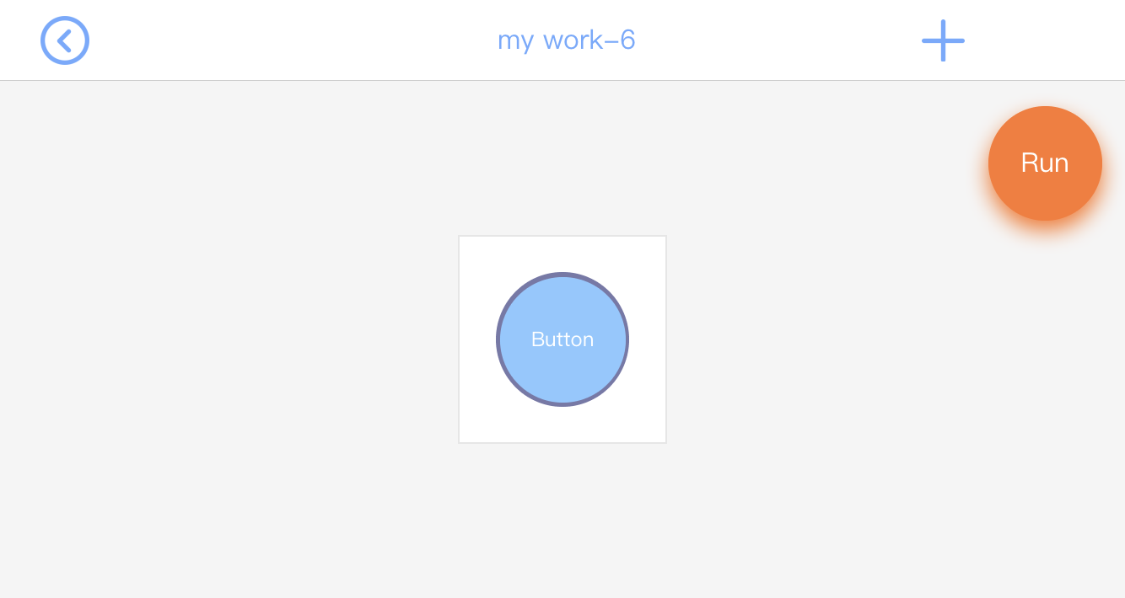
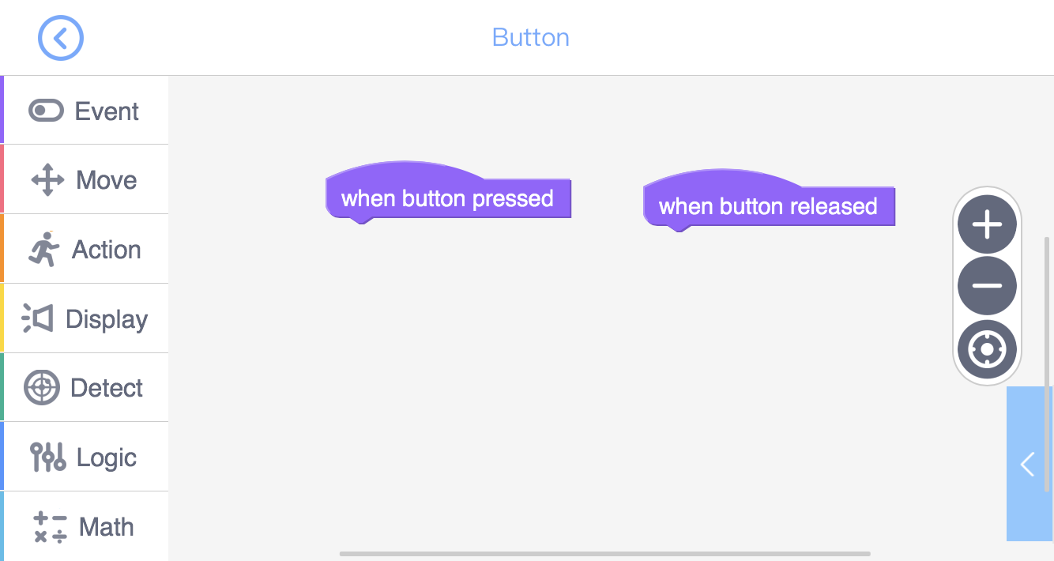
The code library is on the left side of the panel, which contains all the code that we can use to programme for GEIO. Let’s take some time to check them out.
Open the GEIO Edu APP and create a new work. It is clear that we can choose from the above modules to build up our control panel.
Here we take the module “Button” as an example. Choose “Button”, and the icon will appear on the control panel.
Click the “Button” icon to enter the programming panel.

Slide 8
Starting codes
Moving codes
Codes for head motion, combat and HP setting
Codes for lights and sounds
Codes for detecting and sensing
Logic control codes
Codes for data and variables

Slide 9
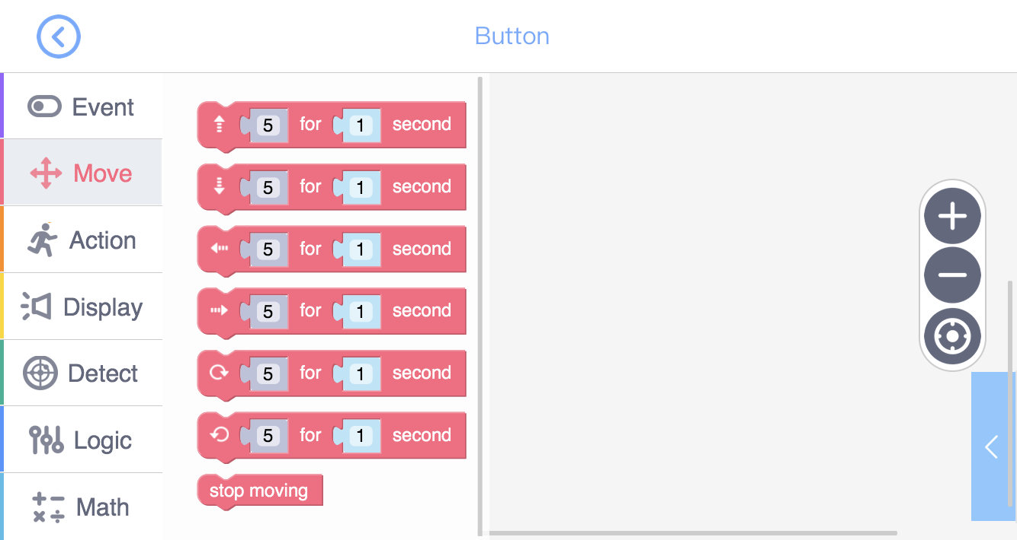
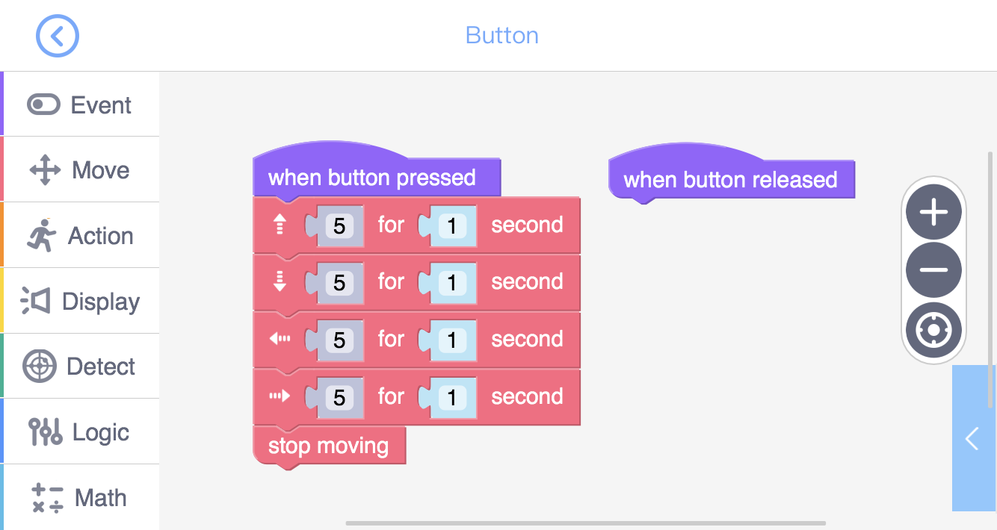
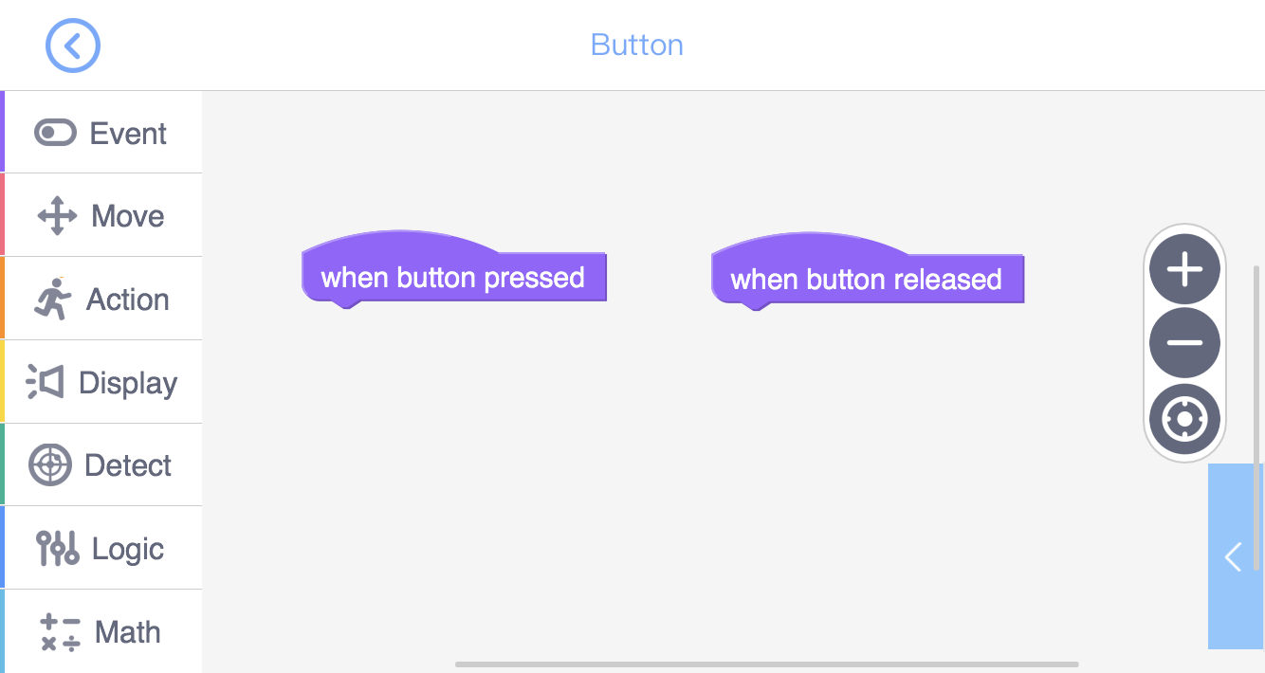
In the “Move” toolkit, we can find codes that control the movement and turning
in different directions. Different from the codes in the “Event” toolkit, the “Move”
codes can be attached to other codes, thus they are the functioning codes.
Carefully observe these two codes. These kind of codes cannot be
attached to other codes. Actually these are the starting codes of the
programme. A programme will always start from such codes.
Take a look at the above programme. When start, the programme will execute the codes
one by one from the top to the bottom. This is the sequential structure.
We can find two purple codes in the “Event” toolkit:
“When button pressed” and “When button released”.
Now let’s programme and make GEIO move!

Slide 10
Training

Slide 11
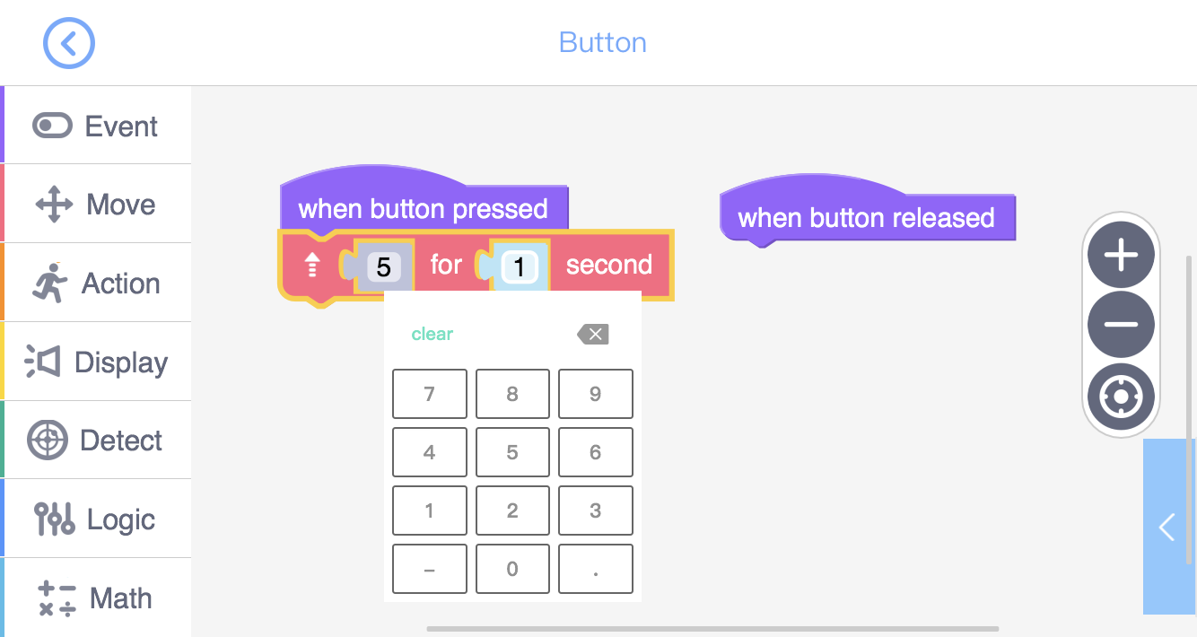
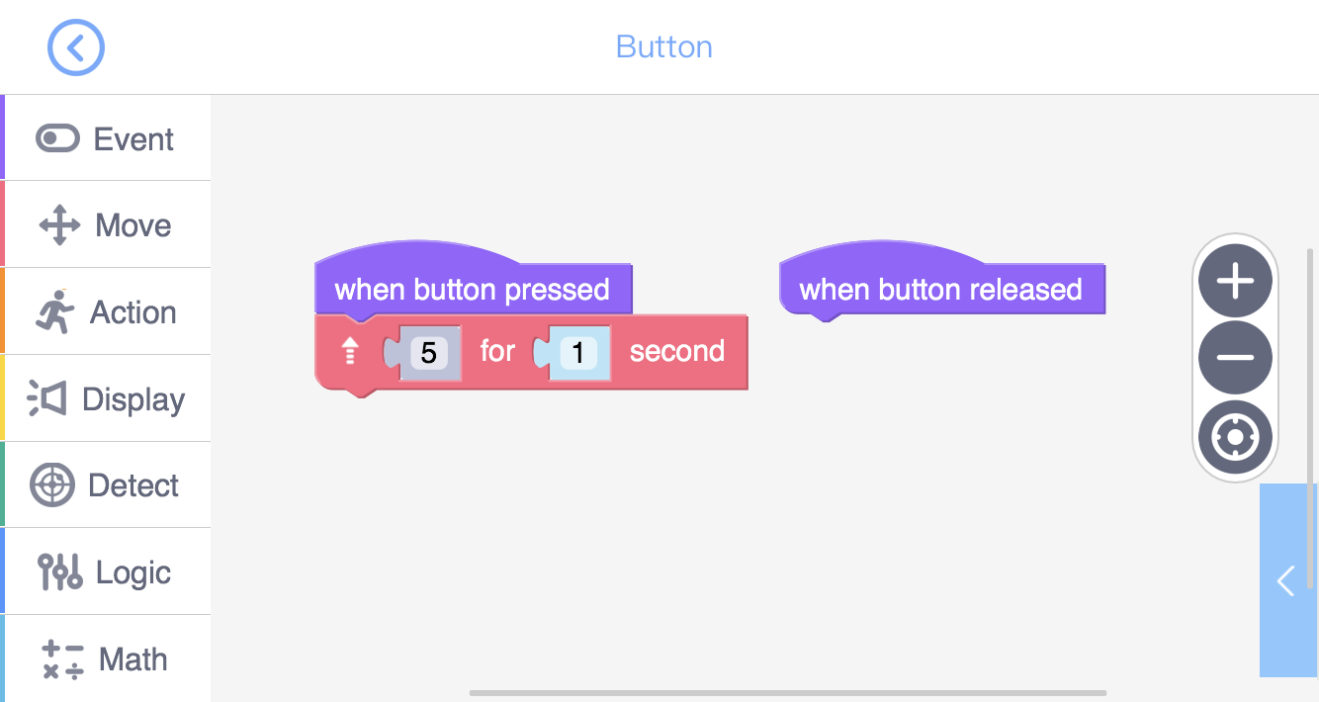
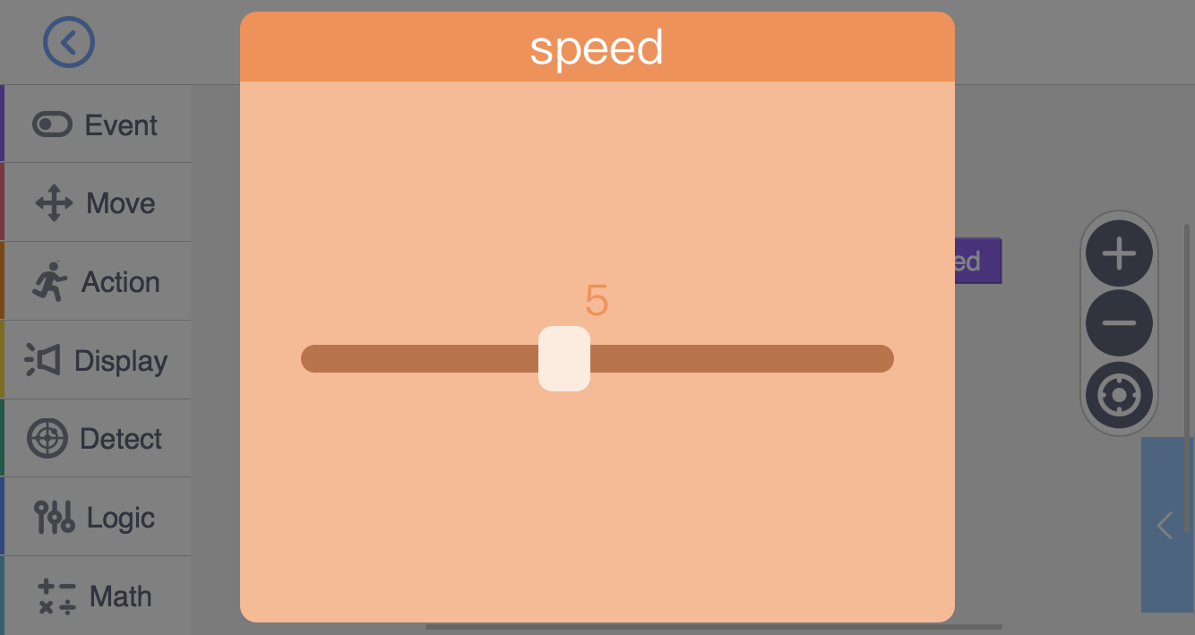
Task 1: Programme the button. When button is pressed, GEIO
should move forward for 3 seconds at speed 1, 5 and 10 respectively.
There are two parameters to be set for this code: speed on the left,
and time on the right. Click the number to set the parameter.
Drag and drop this code to attach it to “When button pressed”.
To do this, we should first find the proper code.

Slide 12
Task 2: Programme GEIO, so that when the button is pressed, GEIO will move forward at speed 5, and when the button is released, GEIO will stop immediately. You will need “Stop moving”.
Good! Now it is the time for your first challenge.

Slide 13
Challenges

Slide 14
Have you noticed that there is a number standing for the speed in the
“Move” code? What is the actual speed for GEIO? Your first challenge
is to find out the real speed for GEIO by tests and measurement.

Slide 15
Speed—v Moving distance—d Time—t
v=d/t
The speed of an object is the distance travelled by the object in a certain time interval.
According to the above equation, we shall programme GEIO to make it move at a certain speed for 5 seconds (t), and then measure the distance it travelled (d). With (d) and (t), we can easily find (v).
Beware! You will need to experiment at least three times to ensure the precision of the results.
Come on, pilots! Try to find the speed for the number 1, 5 and 10!
Let’s first see how to calculate the speed.

Slide 16
What is a robot? What can it do for us?
What does a robot consist of?
How to measure the speed of an object?
Bravo! We know the real speed of GEIO, which will be very useful in our future study.
Before we dismiss, I’d like to ask some questions.
That’s the end of this class. See you next time!

