Slide 1
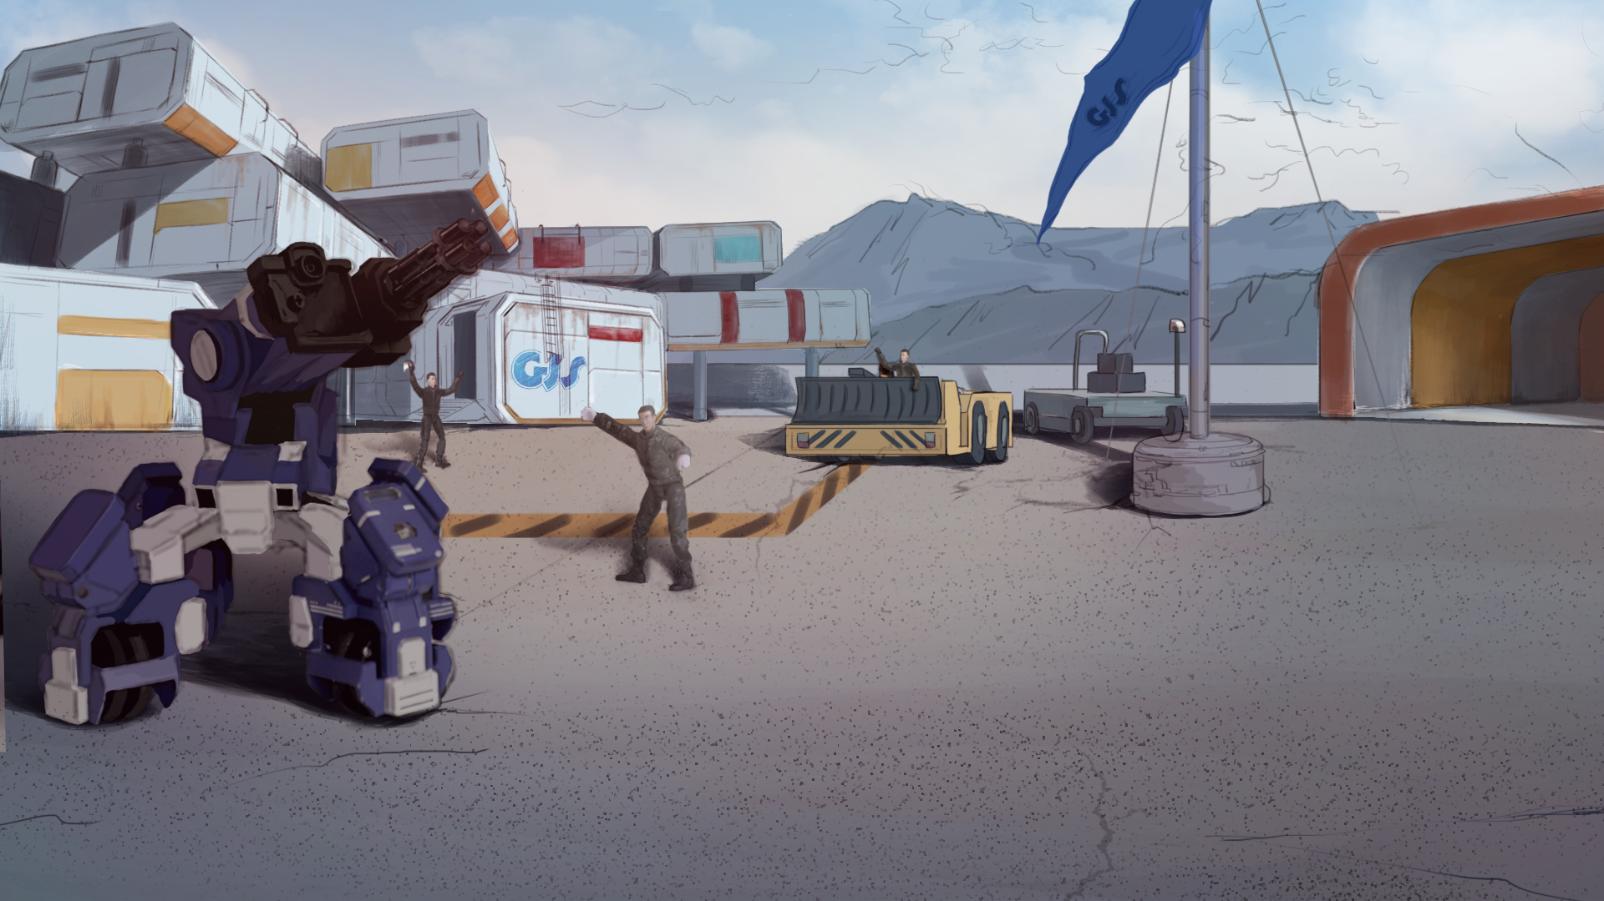
How to Become A GEIO Pilot？
Lesson 9: Patrol

Slide 2
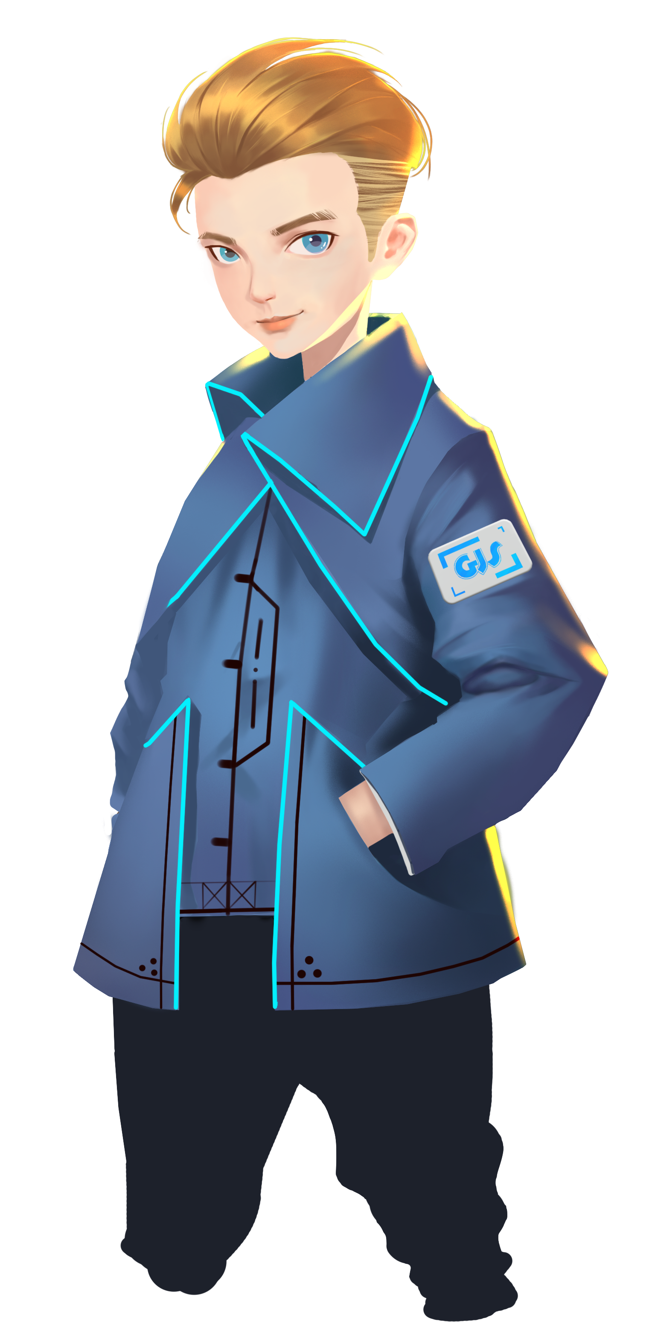
How many ways of data display does GEIO have?
What is the difference between “Display” and “Button”?
How to find out the range of GEIO’s HP?
From this day on, you are official GJS soldiers. And you are going to have your first task.
Pilots, are you ready?
Welcome back fellow pilots! I am Sam. Do you still remember what we have learnt last time?

Slide 3
Briefing

Slide 4
Topic
“Patrol”
Basic Knowledge
Variables
Training
Build a counter
Challenge
Scheduled patrol
In the Briefing section, let’s see what we are going to learn today.

Slide 5
Basic Knowledge

Slide 6
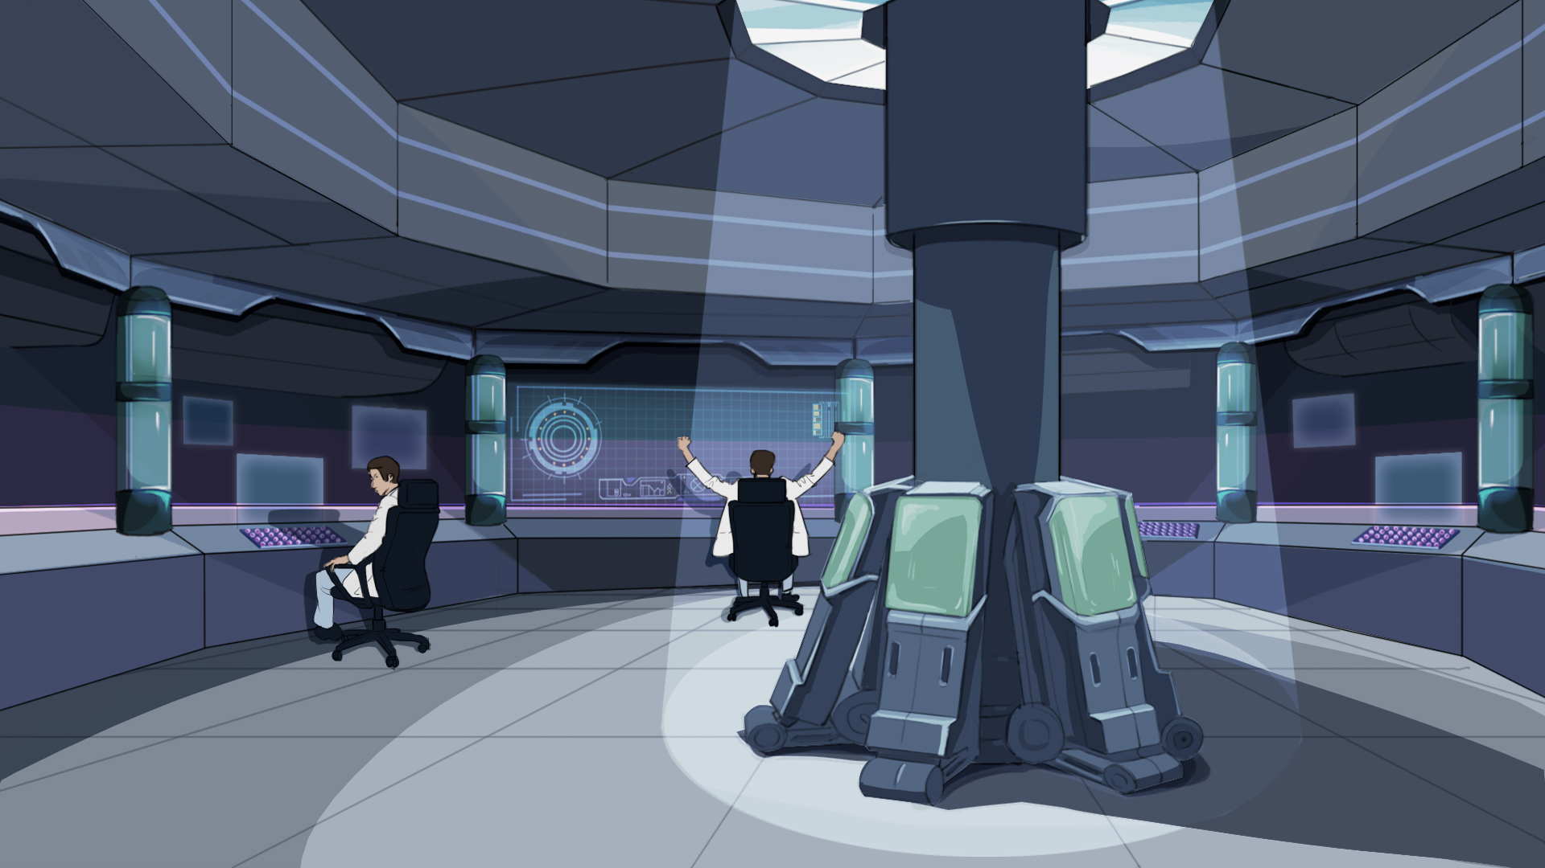
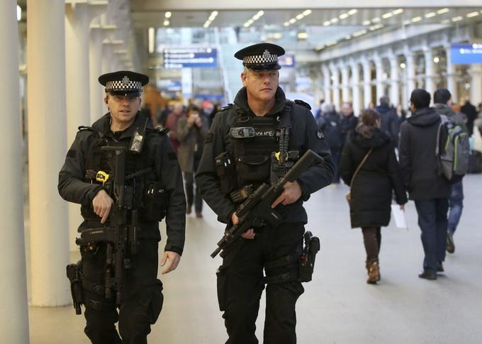
In cities, there are various kinds of patrollers. They walk around and keep an eye on what
happens aside, so that the bad guys have no chance to commit crimes. In our camp,
we also need patrol team to keep the terrorists from making attacks or stealing intelligence.
To become a top soldier, you have to start from the fundamental.
Among all the jobs here, patrol is the most basic one.
Here in GJS team, we use GEIO to patrol around the camp.
But how to do a scheduled patrol?

Slide 7
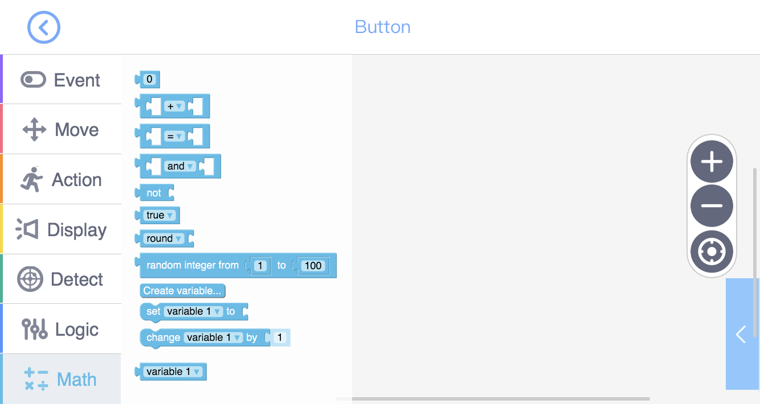
Number
Calculation
Comparison
Data rounding
Random number
Create, initiate and change of variables
Variable (to be used in other codes)

Slide 8
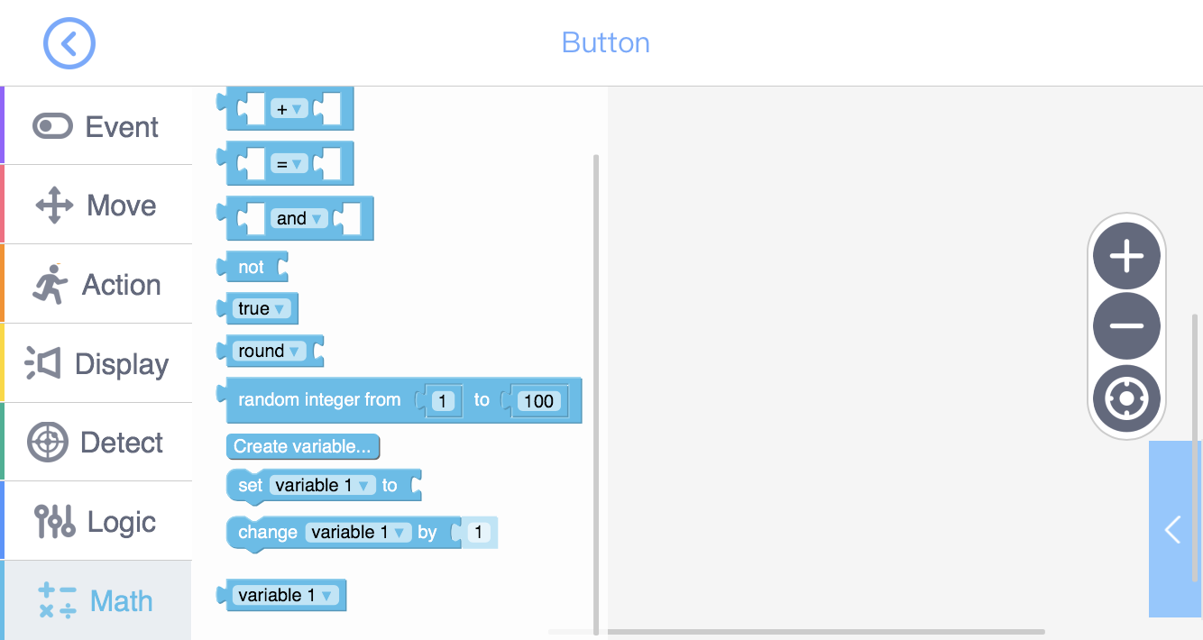
Variable is a special number whose value is changeable as the circumstance changes.
For example, time, age, and the length of a man’s body etc.
How do we use variables? Remember, you should always set a variable before using it
(give the variable a initial value). Otherwise the value of the variable is 0.
There are also variables in the programming of GEIO.
We can find the variable code in the toolkit “Math”.
After the variable is set, we can use it to do calculation.
Firstly, we should know what variable is.
Let’s practice the use of variables.

Slide 9
Training

Slide 10
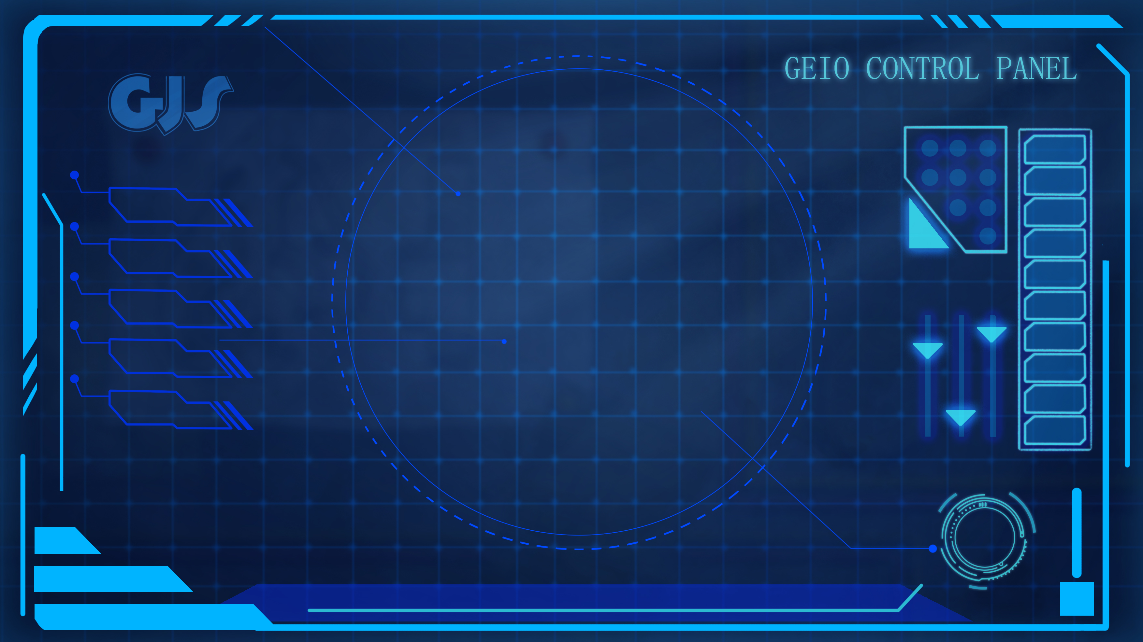
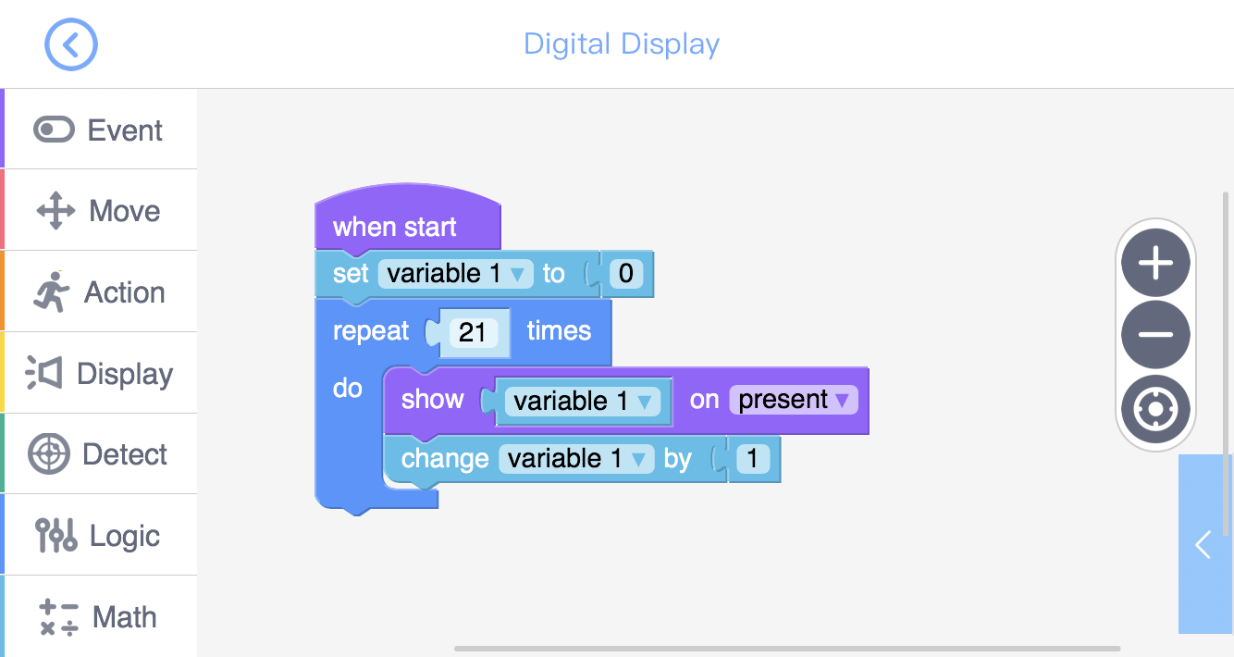
Try the above programme.
Questions: 1. Why use “Repeat Times”? Why repeat 21 times rather than 20?
Training task 1: Use “Digital Display” to build a counter. When start,
the counter counts from 0-20, and display the number.

Slide 11
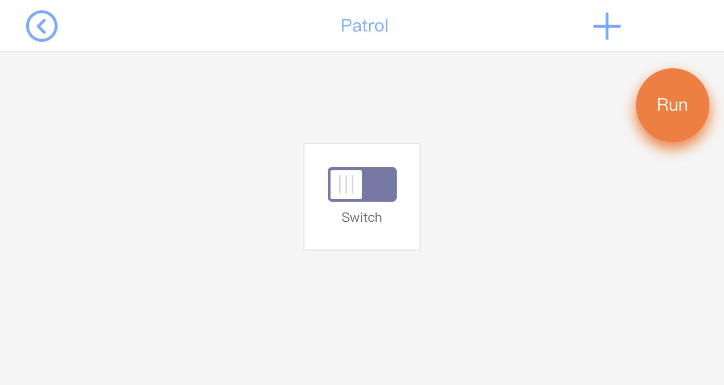
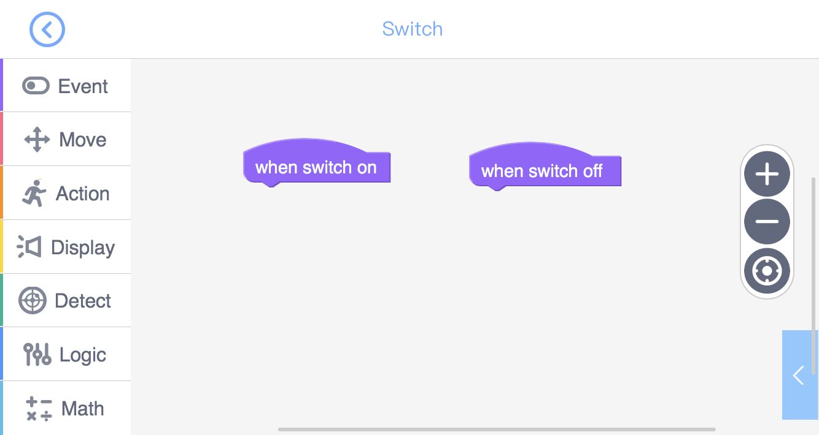
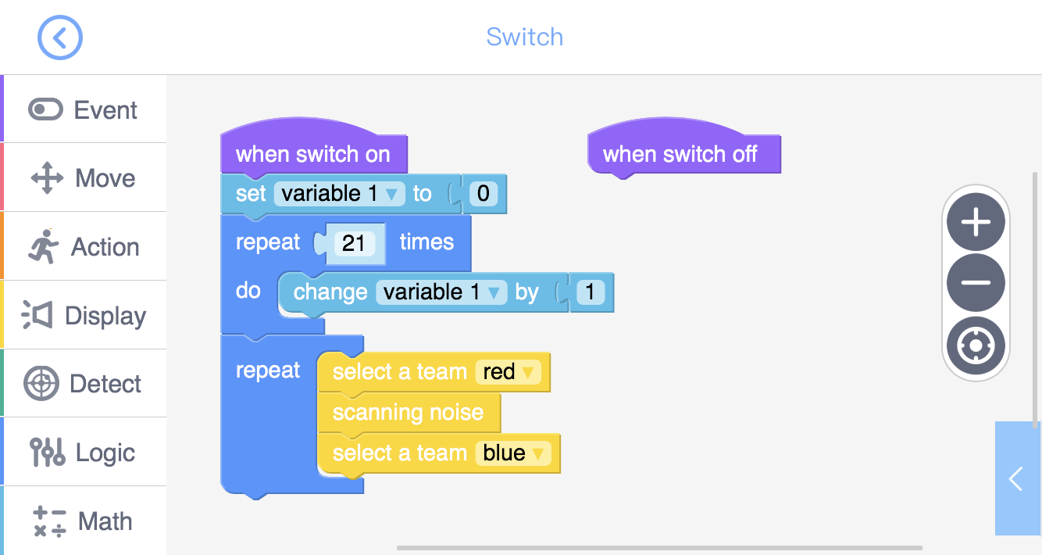
Training task 2: Use a “Switch” to build a alarm. Set the variable to be 0, and counts to 20.
When 20, let GEIO flash red and blue lights and give the scanning sound.
What if we need to activate GEIO’s patrol tour manually? We will need a “Switch”.
Good! Let’s go patrol then!
Alike the “Button”, the “Switch” can be controlled manually after we run the programme.

Slide 12
Challenge

Slide 13
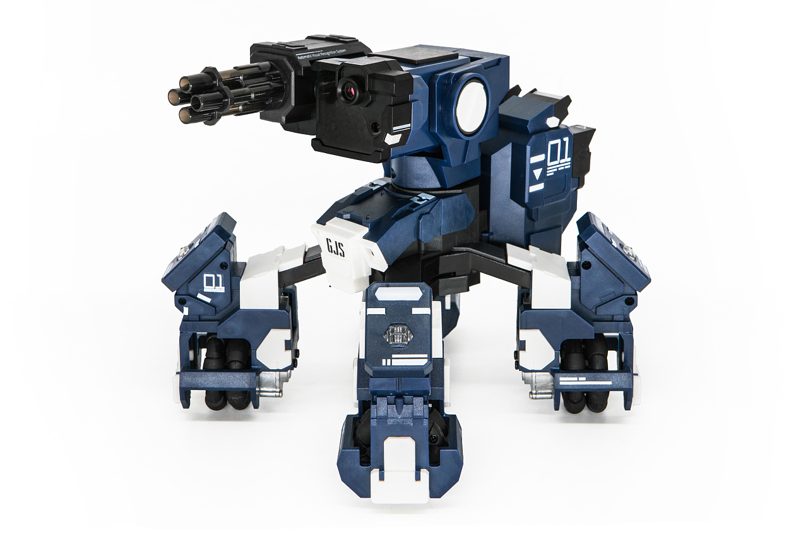
E
D
Start
Look around
Turn 180°
C
B
A
1
2
3
4
5
6
7
8
The patrol begins from C1. After counting from 0 to 20, GEIO should move forward to C4, stops and look around, and continue towards C8. When it reaches C8, it should turn around and return to C1, and then repeats this route at least two times.

Slide 14
What is variables?
What should we do before using a variable?
How many ways of calculating variables are there?
I am looking forward to your greater performance. See you next time!
Now it is the time for the review. Answer the above questions.
Bravo! You have done your first GJS job. Excellent soldiers!

