Slide 1
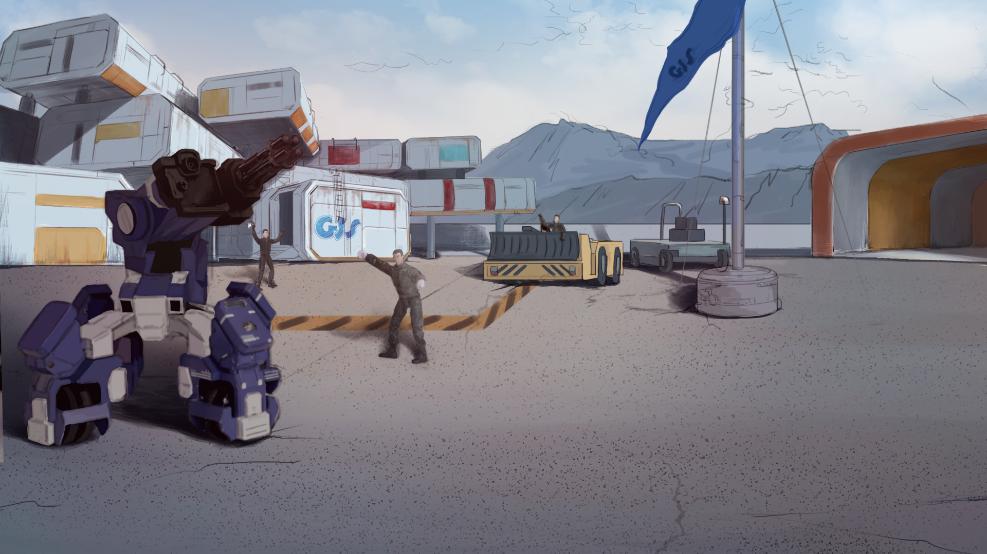
How to Become A GEIO Pilot？
Lesson 8: Battle Simulation

Slide 2
What are logic control codes?
What is flow chart? How to draw a flow chart?
What does the code “repeat times” do?
By now, we have learned and practiced how to accurately control GEIO and the way of
using weapons. So today we are going to have a simulated combat to test your skills.
Welcome back fellow pilots! I am Sam. Do you still remember what we have learnt last time?

Slide 3
Briefing

Slide 4
Topic
“Battle Simulation”
Basic Knowledge
Information display
Training
Data collection and Display
Challenge
2V2 free battle
In the Briefing section, let’s see what we are going to learn today.

Slide 5
Basic Knowledge

Slide 6
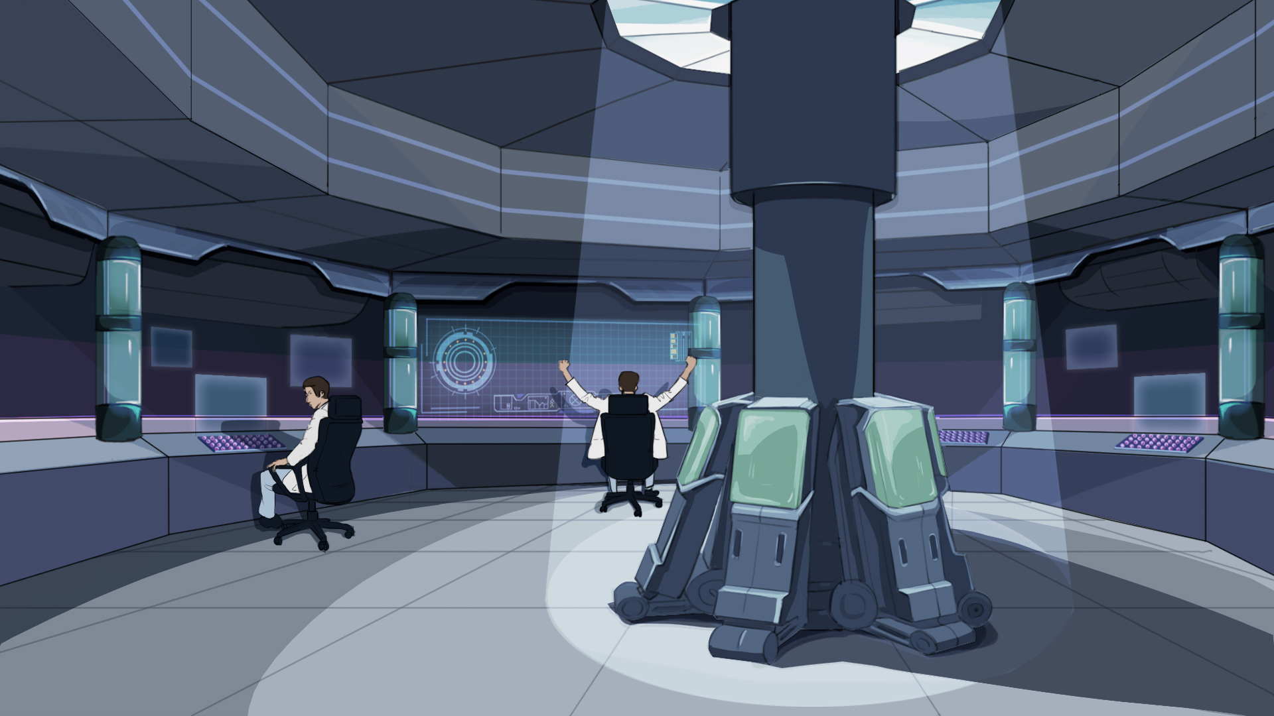
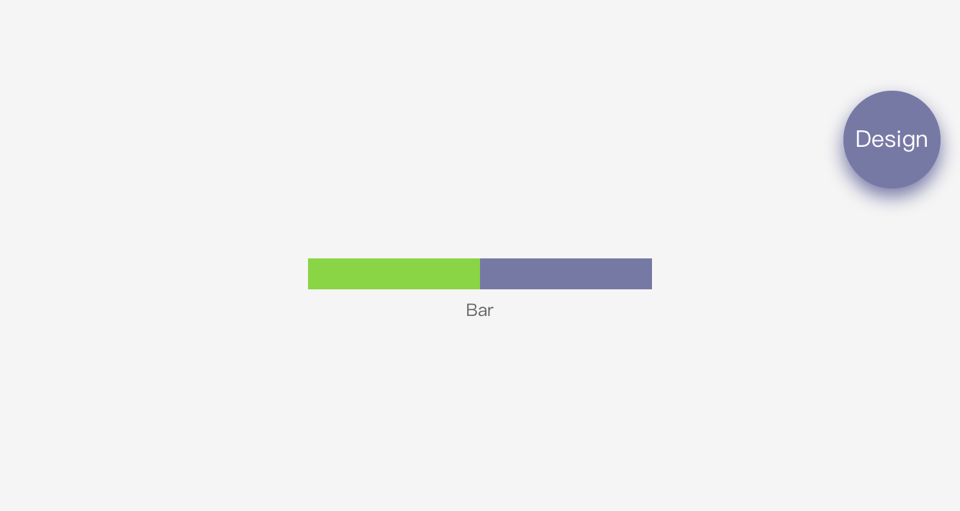
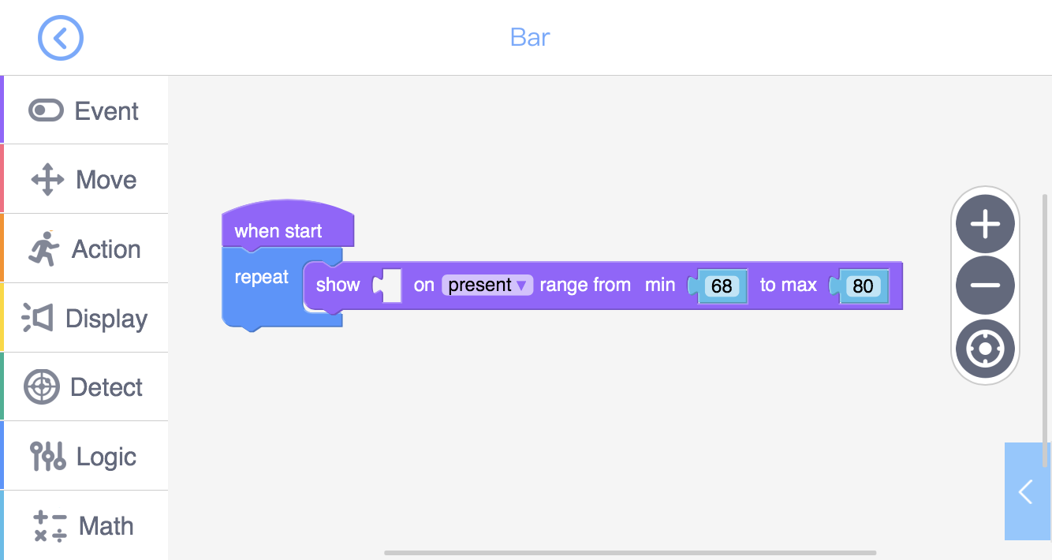
Why do we need the logic control code “Repeat”? Every time we run the programme, the code “Show” would display the target data on the “Bar”. But if the data changes (e.g. HP changes), the “Bar” cannot update at the same time. With “Repeat”, the “Bar” will keep updating.
We have learned how to use the laser gun to attack, and how to restore GEIO’s HP.
But in combat, we need to always be aware of GEIO’s HP in order to do the right thing then.
We can find a lot of applications of the “Bar” in our daily life. The most typical
one is the thermometer. Here the “Bar” can be used to show GEIO’s HP status.
The default programme for “Bar” is as shown above. The code
“Show” can display the data of the content in the pre-set range.
How can we know the current HP of GEIO? We have to use the “Bar”.

Slide 7
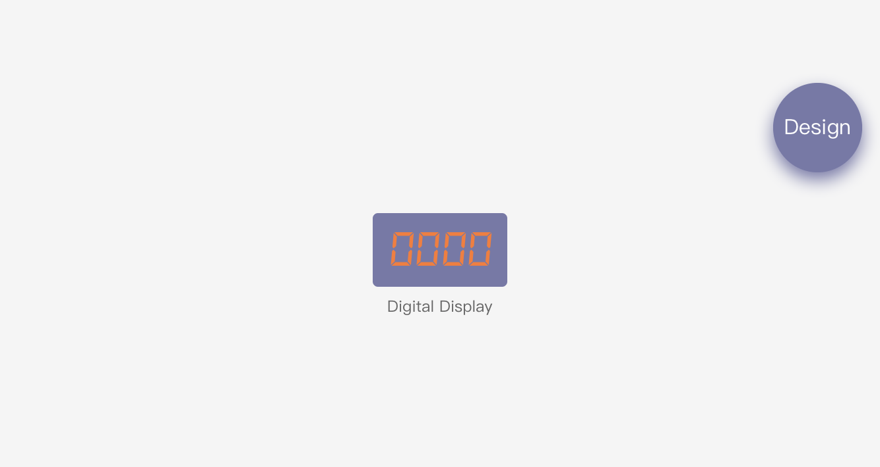
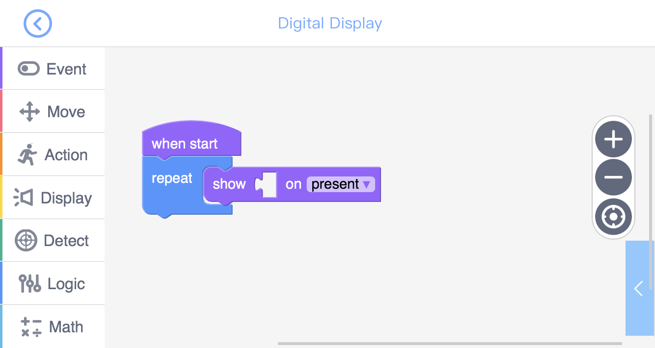
We notice that the start code of “Bar” and “Digital Display” is different from that of “Button”.
Data display will begin once the programme is running (do not need to click or press).
Unlike the “Bar”, the “Digital Display” will display the actual number of the target data.
Except for “Bar”, there is another way to display the target data — Digital Display.

Slide 8
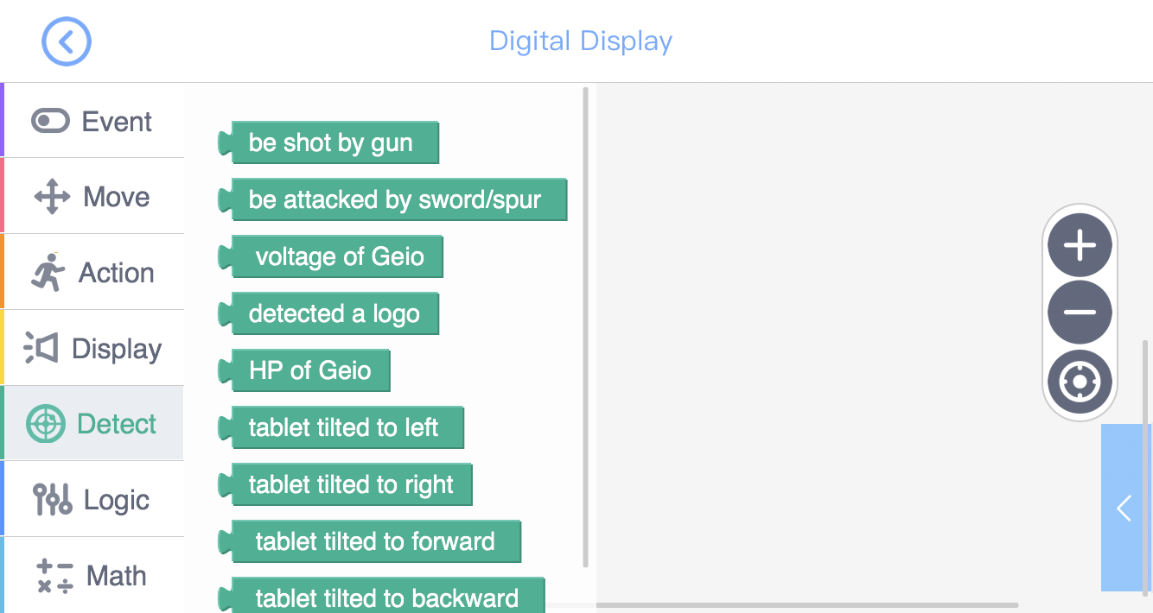
In the“Detect” toolkit, we can find the code “HP of GEIO”. With this code,
we can collect the real-time HP data of GEIO, and use it in the display.
We now know how to display data. But how can we display GEIO’s HP?
Let’s do some training.

Slide 9
Training

Slide 10
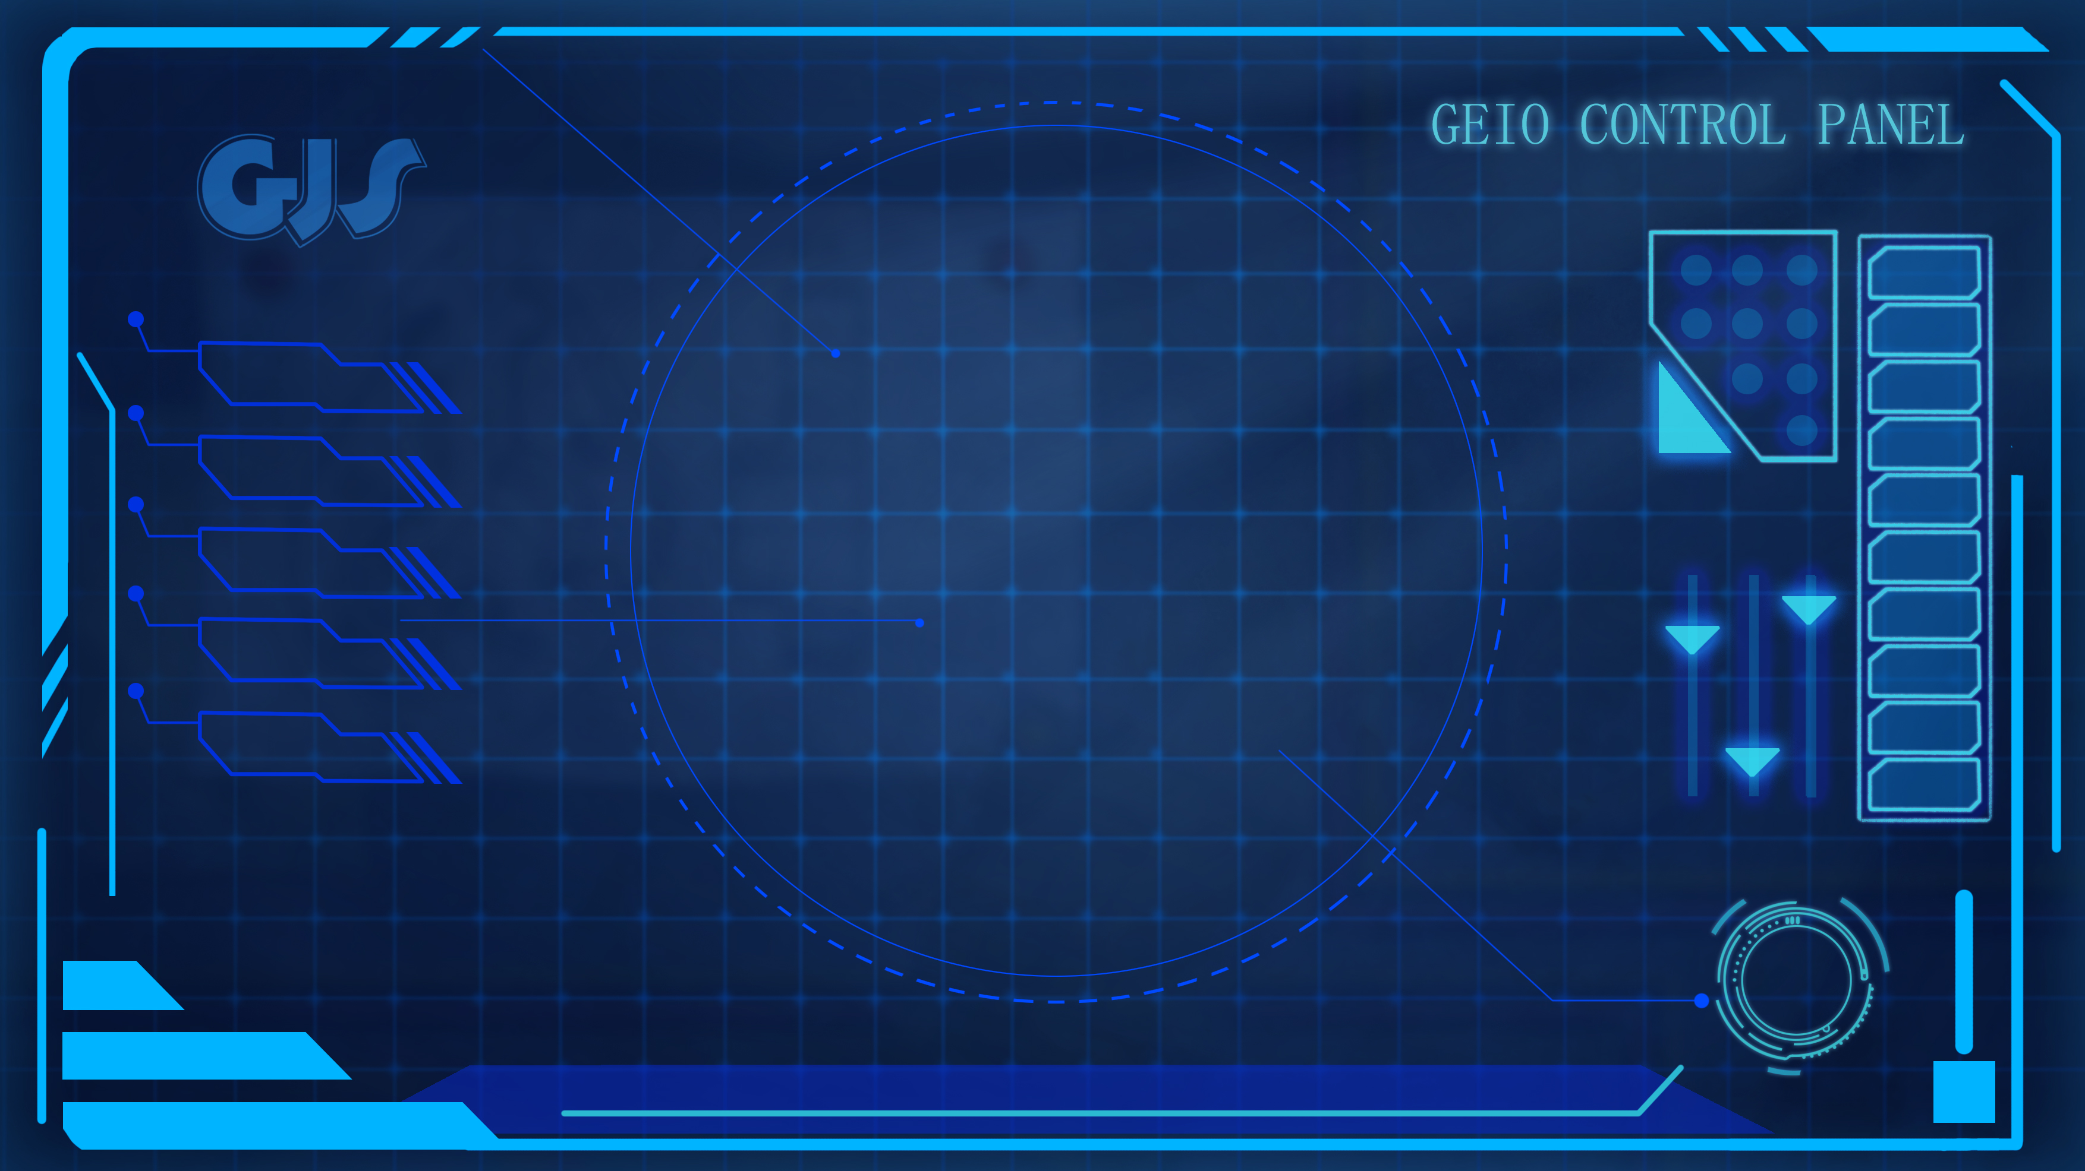
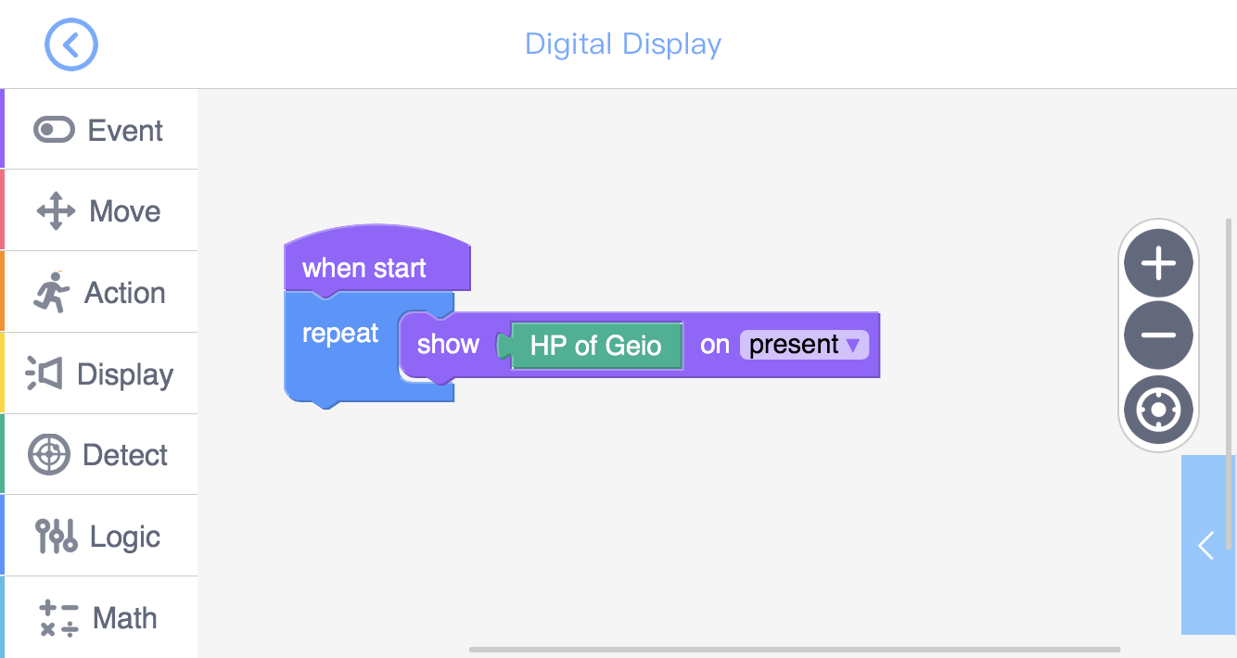
Training task 1: Build the HP display system using “Digital Display”.
Cooperate with your team mates to find out the actual HP range of GEIO.

Slide 11
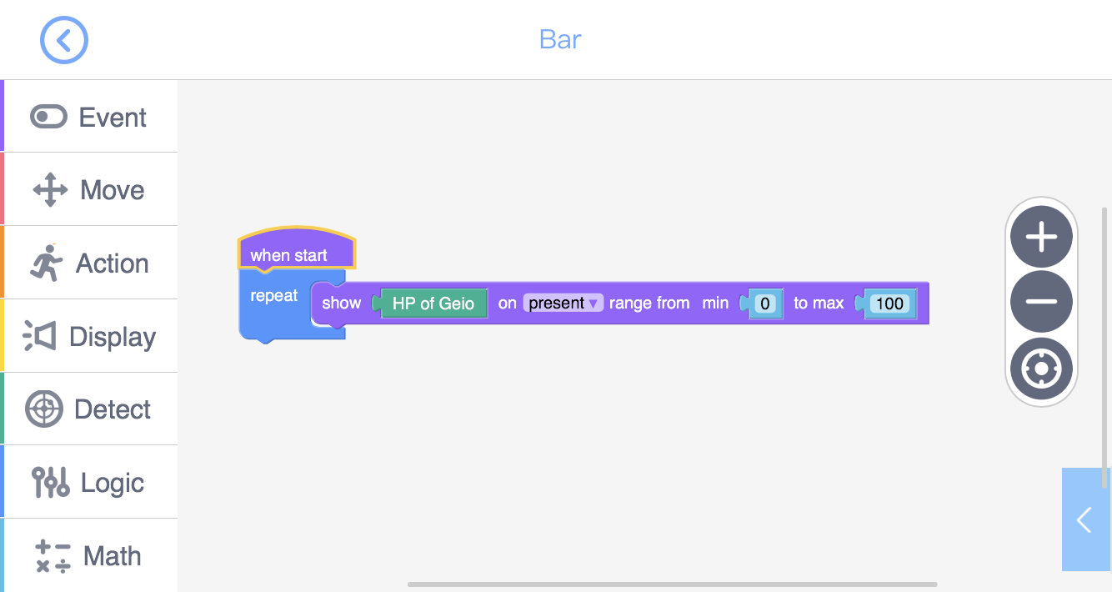
Training task 2: Use the range we find in the last task as
the display range of “Bar”, and display the HP of GEIO in “Bar”.

Slide 12
Challenge

Slide 13
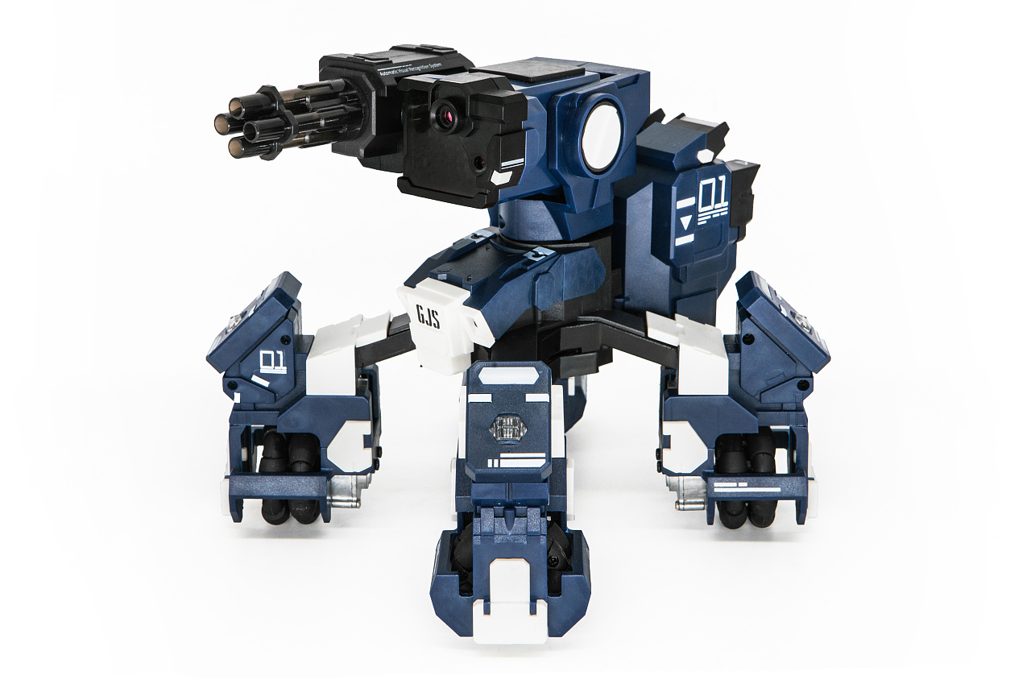
E
D
C
B
A
1
2
3
4
5
6
7
8
Now is the time for the 2v2 battle simulation. Every two will form a team, and
every two teams will be fighting against each other. This time, there will be six
obstacles in the middle of the field which can be used as cover.
Rules: 1. Ammunition limitation (10 times) and emergent reload system;
2. Use “Bar” to display GEIO’s HP;
3. Use buttons to control GEIO’s motion; 4. Restore HP is banned during the battle.
The team which first lose all their members is considered to be defeated.
Now you can begin your preparation.

Slide 14
How many ways of data display does GEIO have?
What is the difference between “Display” and “Button”?
How to find out the range of GEIO’s HP?
You have by now finished all the training classes in this training camp. From next time on,
you will be official GJS pilots and attend practical operations. Prepare yourselves, and
get ready for the coming challenges!
Now it is the time for review. Answer the questions above.
What excellent competition it is!

