Slide 1
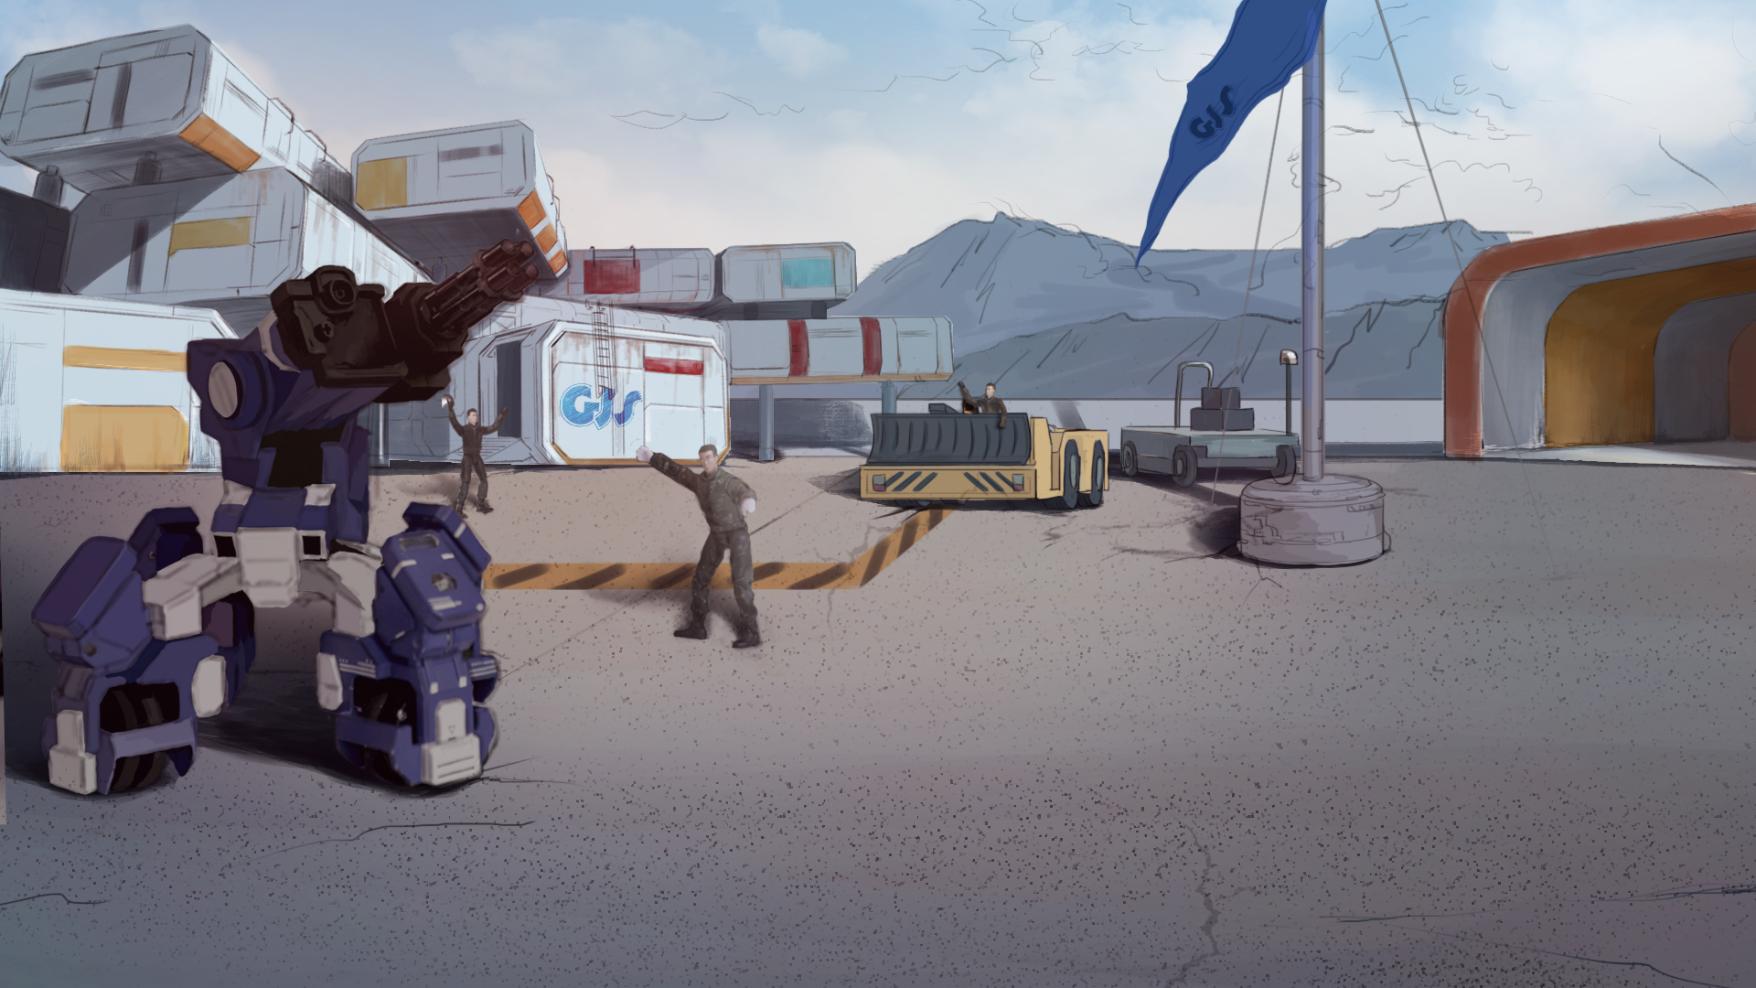
How to Become A GEIO Pilot？
Lesson 4: Who is the Champion?

Slide 2
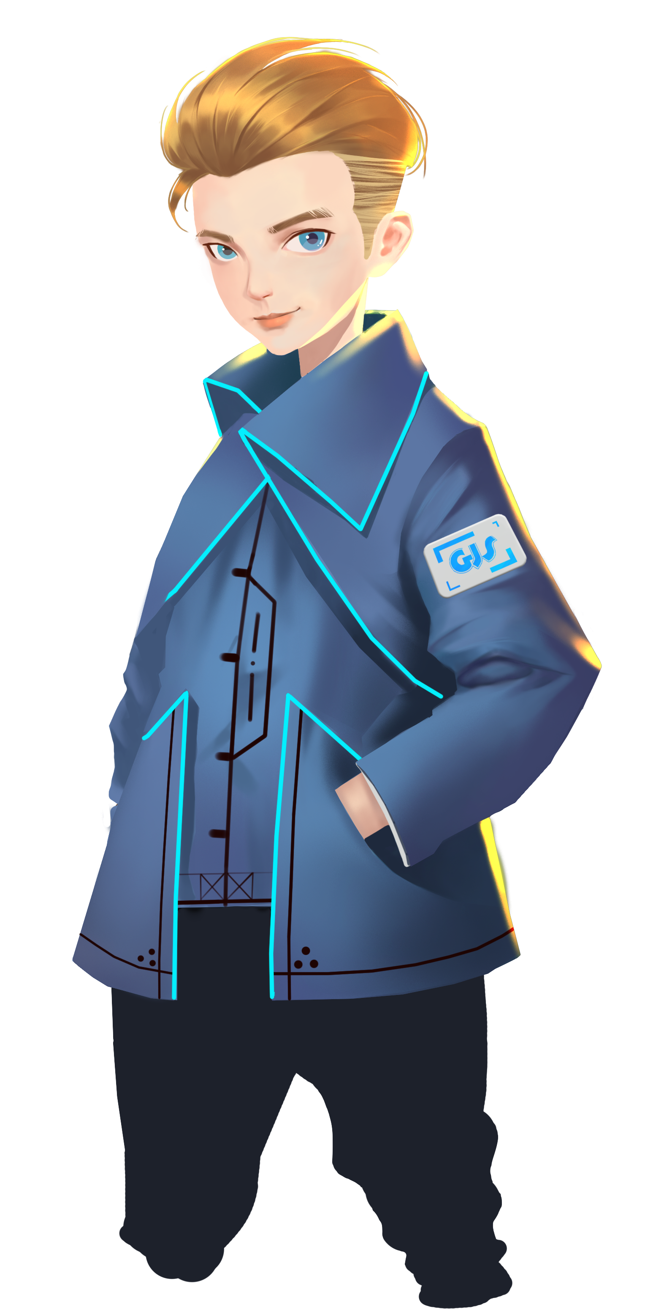
What is the degree of freedom?
What is a coordinate system?
How to determine the position of an object in 3-D space?
We have been learning and practising the programming for GEIO motion control
for the last three classes, and I believe you have gain a comprehensive understanding
of those knowledge. Today we are going to have a quiz. Are you ready for it?
Welcome back fellow pilots! I am Sam. Do you still remember what we have learnt last time?

Slide 3
Briefing

Slide 4
Topic
“Who is the Champion?”
Basic Knowledge
Review on GEIO motion control
Training
Programming for GEIO motion control
Challenge
Maze Race
In the Briefing section, let’s see what we are going to learn today.

Slide 5
Basic Knowledge

Slide 6
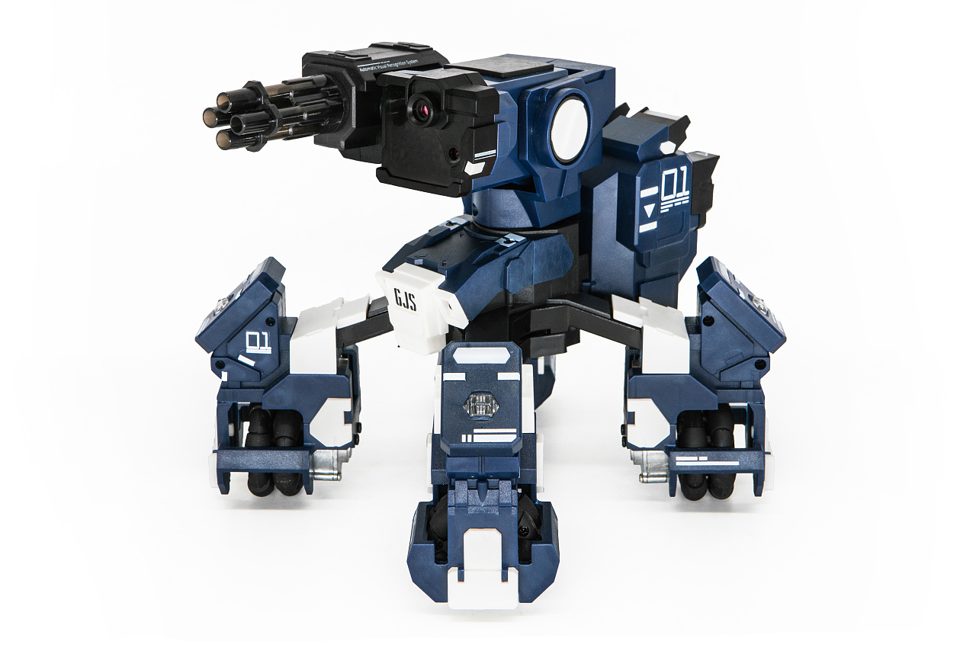
Firstly, we shall recall some of the knowledge on robots.
Question 1: What are the three main parts of a robot?
Question 2: How to calculate the robot’s speed?

Slide 7
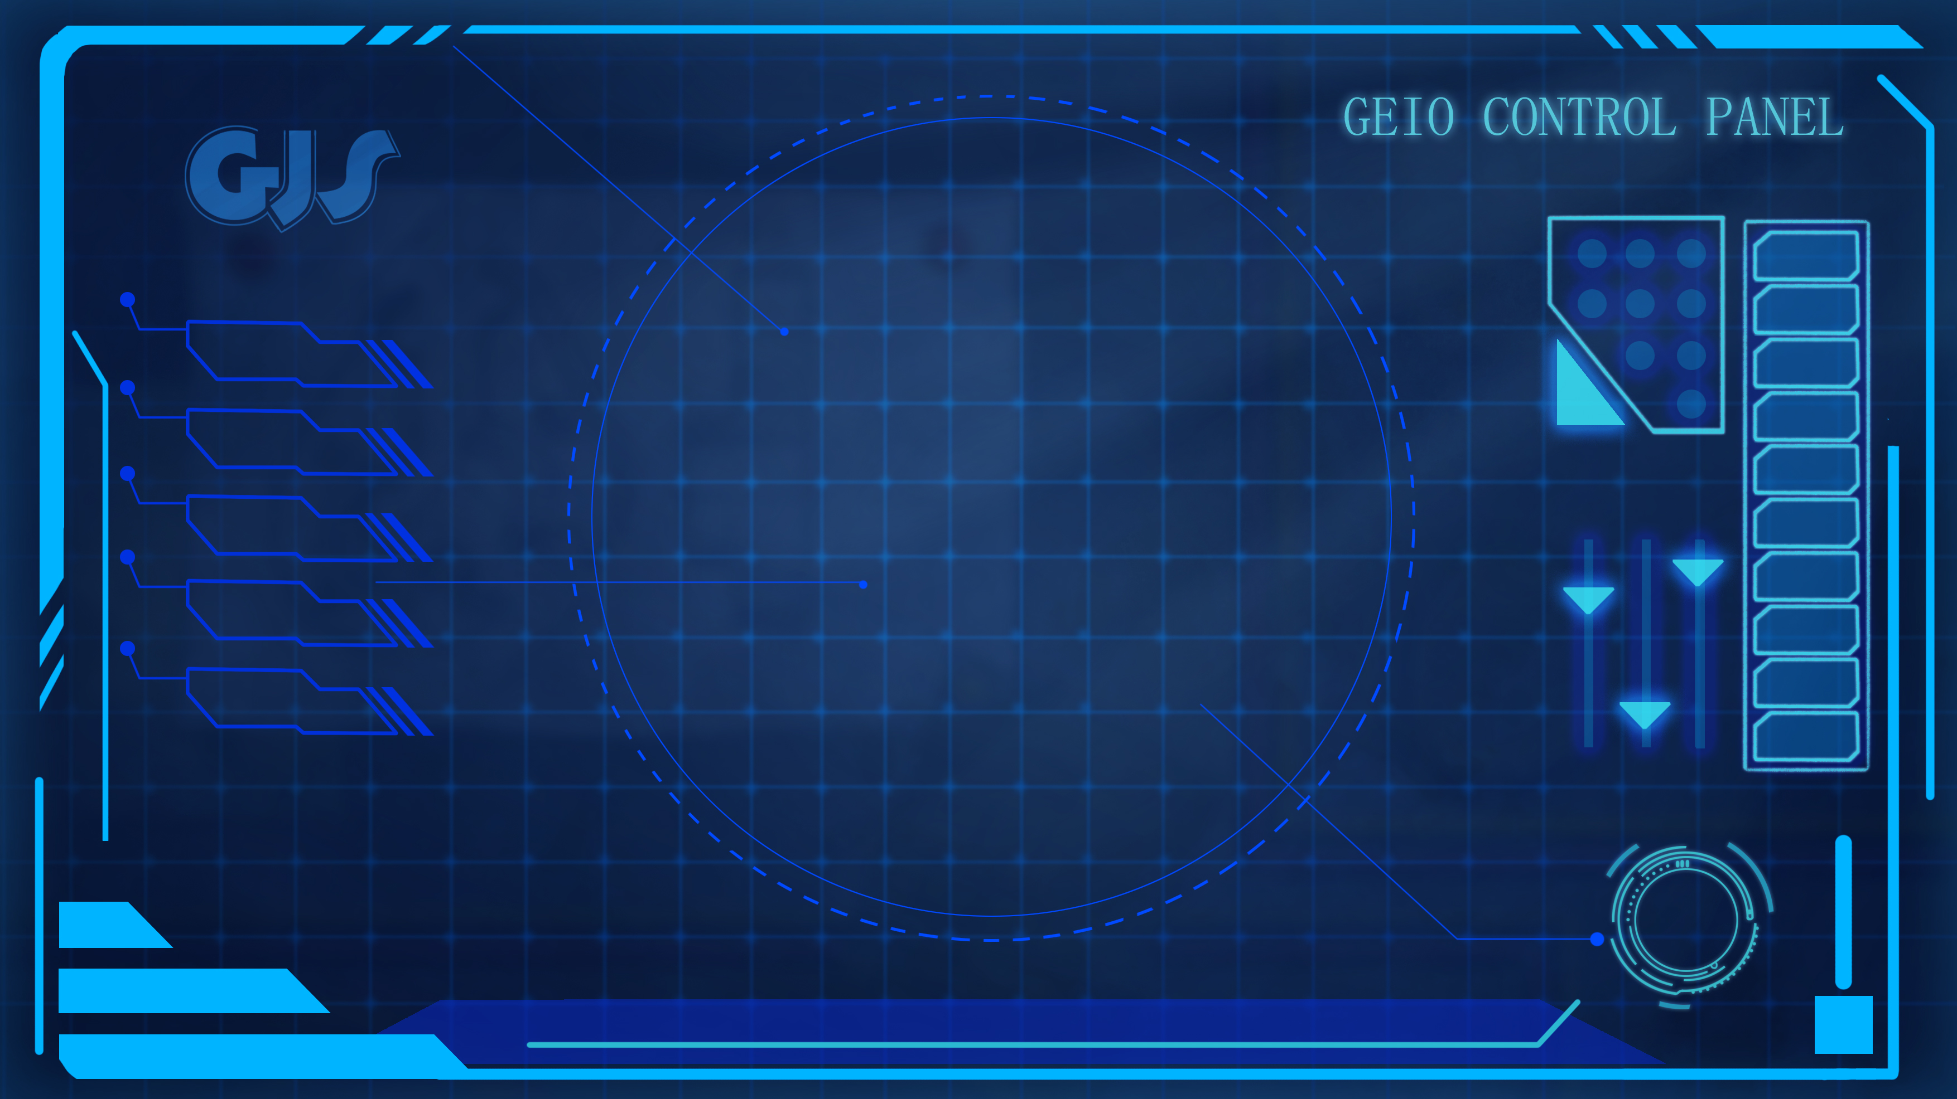
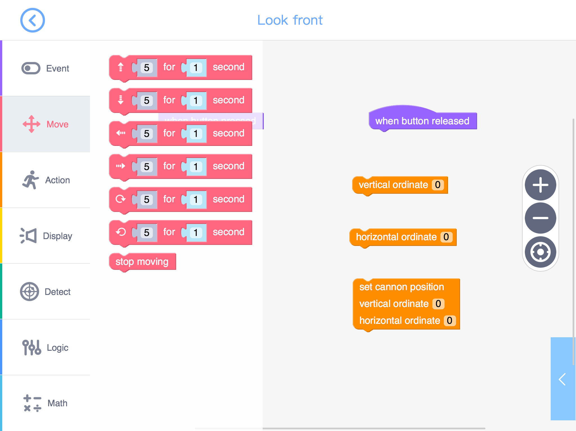
The above image shows the codes we have learned and used to control GEIO’s motion.
What can they do in the programme?
In the past several classes, we have learned how to programme GEIO to control its motion.
Let’s practice again the motion control codes.
Brilliant! Let’s continue to the training tasks.

Slide 8
Training

Slide 9
Obstacle
GEIO
Training task 1: Avoid obstacles. There are several obstacles in front of GEIO.
Your task is to programme GEIO and control it to go bypass the obstacles.

Slide 10
Training task 2: Golf player. This time we need to refit GEIO by adding a “golf stick” to its laser gun. Programme to control the head motion and knock the ball off the table.

Slide 11
Challenge

Slide 12
After the warm up tasks, I believe you are fully ready for the coming quiz.
Ok, let the quiz begin!

Slide 13
S
B
D
Edit and programme (use buttons) your GEIO. Set out from S point and move towards the
basket; lift up the basket and delivery it to the position with the trolley icon; put down the
basket, and use your stick to fetch the ball on the obstacle top and wipe it into the basket.
After that, go to D point to finish the job.
Here we are again in the training field. But this time the field is a bit different.
Use the knowledge correctly, and it will be easy for you to finish this job!

Slide 14
What are the main parts of a robot?
Why is programming important?
What actions can GEIO perform?
Next time, we will begin to learn more complicated codes and actions,
and control GEIO to do more difficult tasks.
Are you expecting the coming lessons? See you next time!
Now we should review. Answer the above questions.
Excellent! You are making progress!

